Slide 1
LESSON 3, PART 1 GYPSY & TRAVELLER HOMES

Slide 2
HOMES
Notes:
Gypsies and Travellers live in a variety of different homes and in a variety of different places. This has changed over time with many Gypsy and Travellers now living in homes.

Slide 3
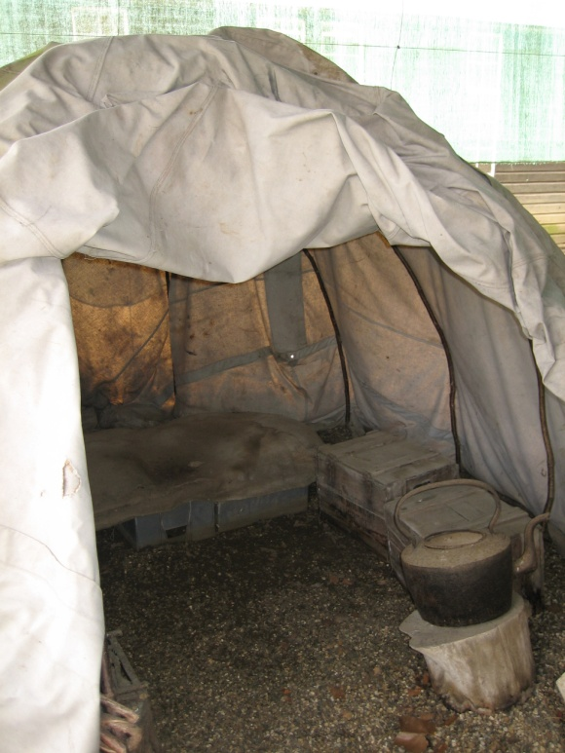
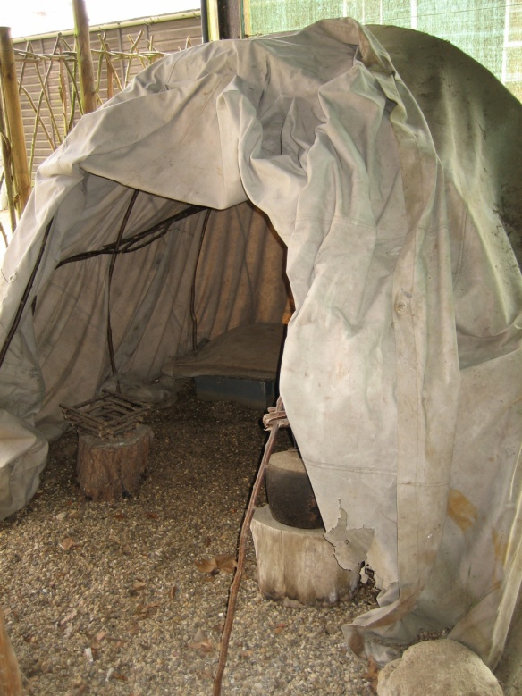
GYPSIES AND TRAVELLER S EARLY HOMES
Originally Gypsies would travel on foot and
build "bender" tents.
Notes:
Benders were so called because they were made from supple branches which they bent inwards to support a waterproof covering

Slide 4
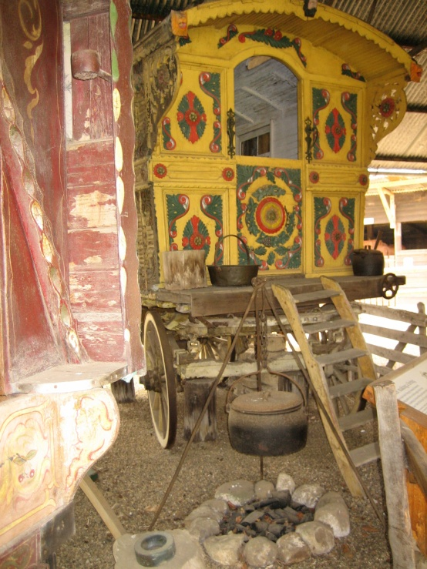
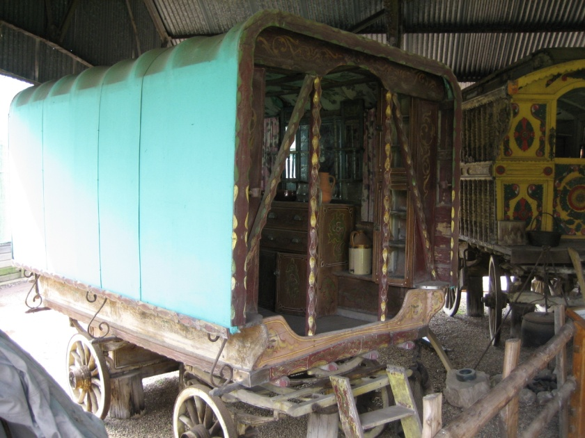
VARDO
In 1830 Gypsies and Travellers started to
use a Vardo which is a covered
traditional horse drawn wagon.
Notes:
The design of the vardo included large wheels running outside the body of the van, which slopes outwards considerably towards the eaves

Slide 6
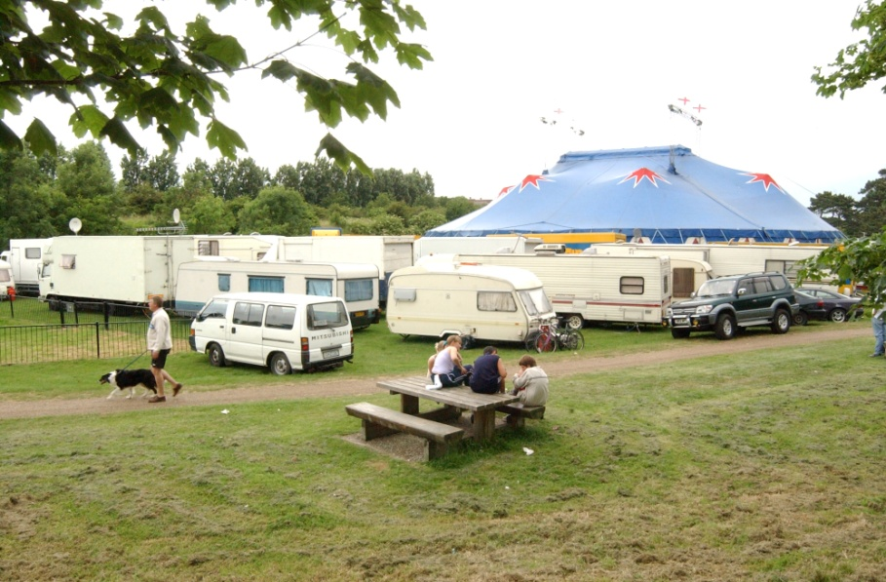
FAIR AND CIRCUS HOMES
Notes:
In the main, Fairground and Circus families have large coach-built trailers pulled by traction units and over-winter on a permanent site. It is unlikely that they will ever be pitched on a roadside illegally as they move between organised, hired sites.

Slide 7
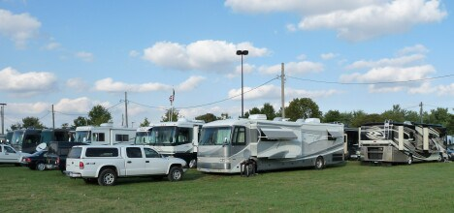

Slide 8
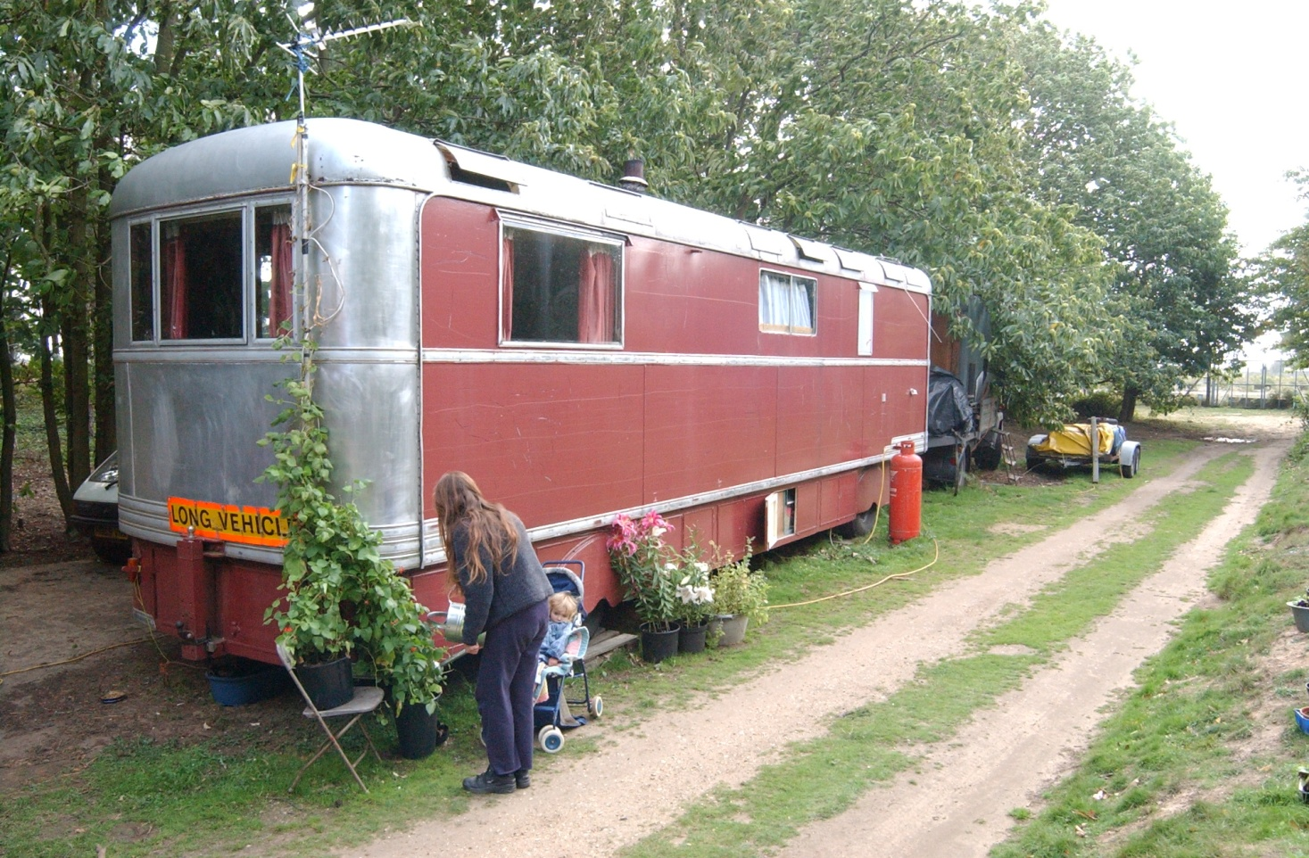
NEW TRAVELLER
Notes:
Their transport and homes consist of vans, lorries, buses, narrowboats and caravans converted into mobile homes. They also make use of improvised bender tents, tipis and yurts. There are also many who now use traditional Vardos as homes.

Slide 9
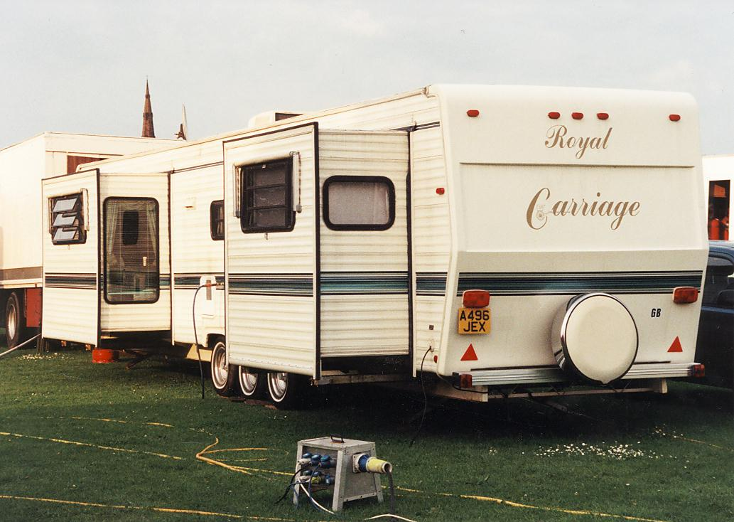
The types of accommodation vary from within different groups of Travellers
Notes:
Living accommodation is as varied as the groups of Travellers themselves. The accommodation itself may vary in standard.
Nearly all difficulties experienced by Gypsies, Irish Travellers and New Travellers are influenced by lack of accommodation on authorised sites.

Slide 10
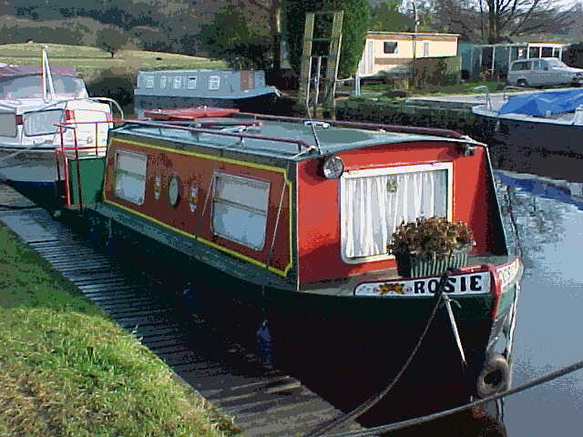
OTHER TYPES OF HOME
Notes:
There are many theories as to where the canal boatmen or bargees came from. Some people believed the boatmen were Gypsies who took to the water but this is certainly untrue.
The development of the canal network in the eighteenth century brought with it the opportunity of well paid jobs on the working barges so probably many boatmen were from the villages alongside the canals who desired a new way of life. They soon established a unique community with a way of life, language and customs of its own. They were sometimes disliked and mistrusted by people of the land.
The decline of the canal industry in the twentieth century led to the loss of this work and lifestyle.
Today many narrow-boats have been converted into living accommodation and families are choosing to live and travel on the canals.
There appear to be a small number of children living on the canals who usually attend a local school.

Slide 11
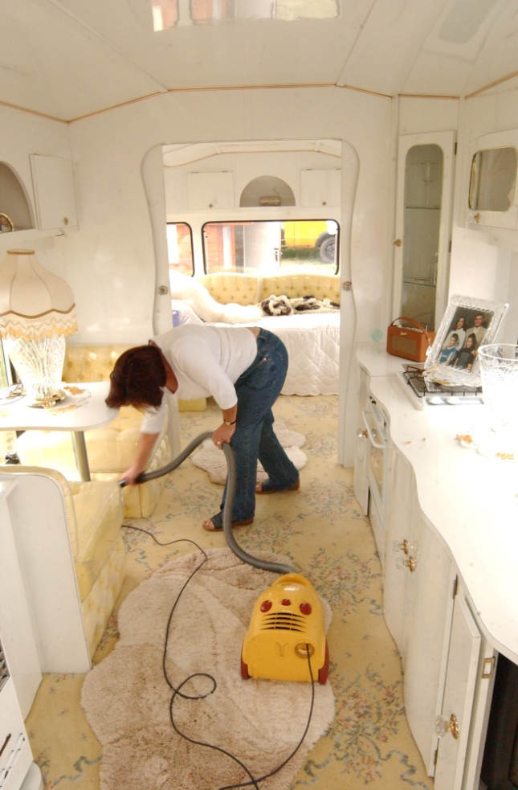
TRAILERS
Many Gypsies and Travellers now live in trailers which became
popular in the 1970s. They can be large and very comfortable.
Notes:
In the 1970’s a very nice trailer could cost £20,000 which is about £112,00 in today’s terms.

Slide 12
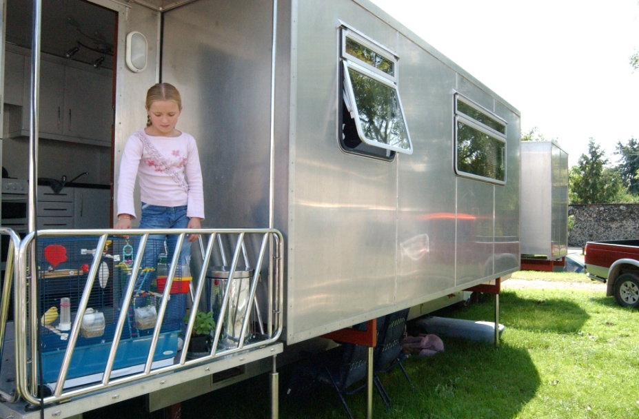
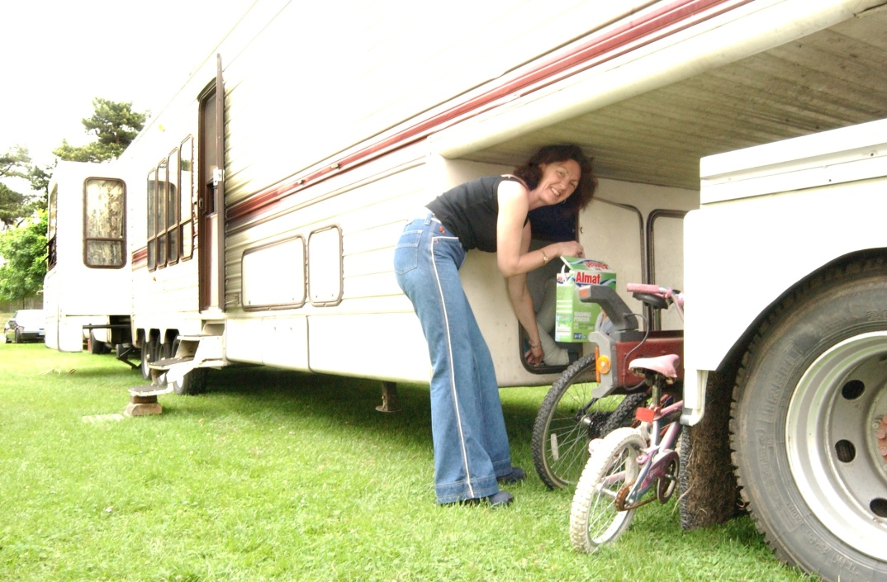

Slide 13
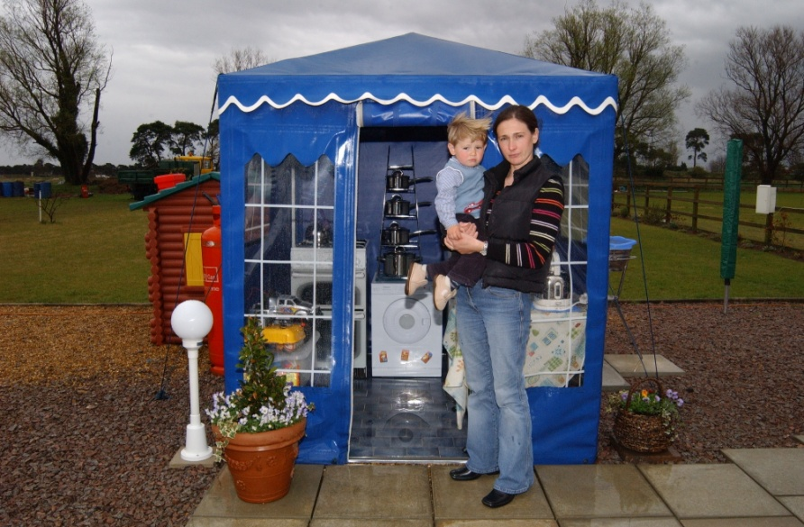
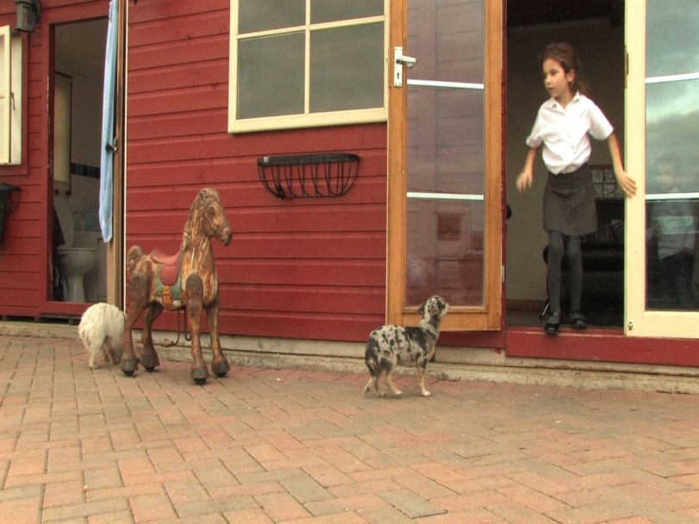
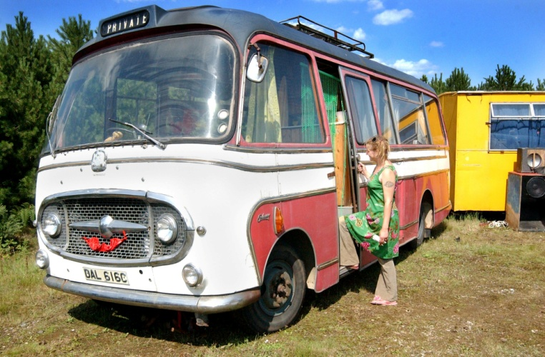
EXTERNAL BUILDING AND OUTDOOR SPACES
Notes:
Many Gypsy and Travellers will only sleep in their trailer and will have other spaces for cooking, school work and living in through out the day. The picture above shows a kitchen area and washing machine and a outside toilet and learning space.

Slide 14
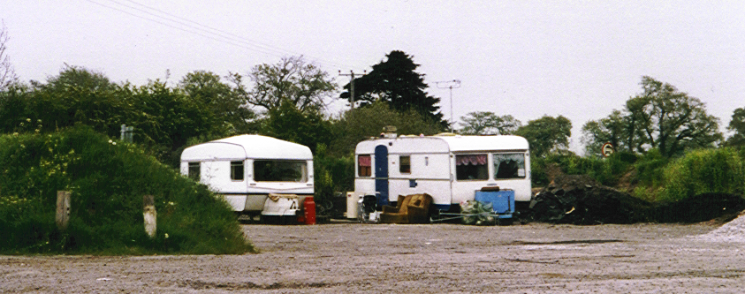
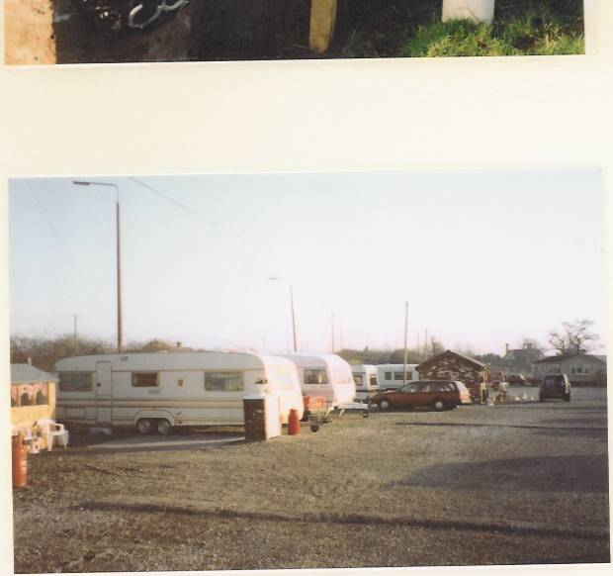
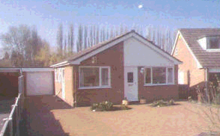
TRAVEL PATTERNS
Nomadic – constantly travelling or travelling for long periods
Occupation
Family connections
Retaining networks
Semi-nomadic – travelling for part of the year
Seasonal occupation
Religious conventions
Family / personal reasons
Retaining networks
Static – travelling for short periods
Holidays
Family visits
Religious conventions
Notes:
There are different travel patterns for a variety of reasons.
Families move into housing but it is often an enforced move because of lack of pitches on sites.
Where travel is for work purposes, over time these patterns have changed. For example - for Showmen the competition from theme parks has caused them to extend their travelling season, for Gypsies the mechanisation of farming has reduced opportunities for work.
The importance of the extended family for these groups affects their movement. For example - family gatherings for christenings, weddings and funerals take priority as does visiting extended family members. Families may therefore travel together in large groups.
Showmen usually have a regular pattern of travel often dictated by the historical calendar of fairs.
Travelling Circuses often move every week throughout the year.
There is a strong revival of evangelical Christian movement in the English Gypsy population – they have their own churches and travel to large evangelical conventions.

Slide 15
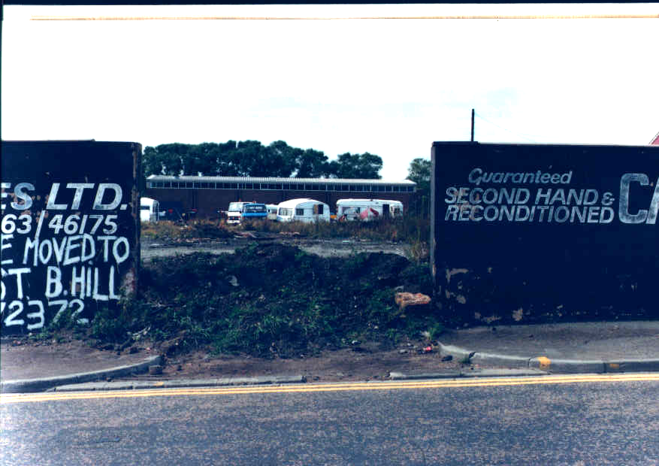
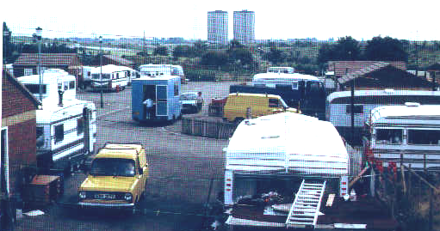
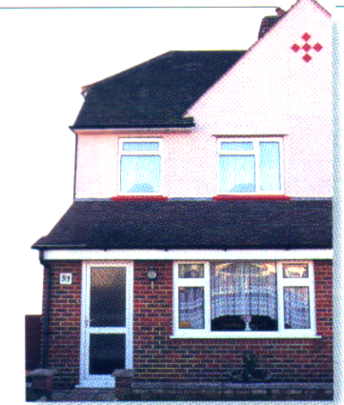
HOMES FOR GYPSIES AND TRAVELLERS MAY BE:
On the roadside
On an official site
In a house
Notes:
LACK OF ADEQUATE ACCOMMODATION
The vast majority of Travellers lead a sedentary way of life either in houses or on council or privately owned sites. Although rent and council tax is charged on sites, there is usually a lack of security of tenure on sites and therefore many Travellers do not have the rights and privileges of householders. Many possess licenses, which in some cases mean that they can be given as little as 7 days notice to leave a site, in spite of the fact they have spent perhaps 20 years living there.
It is often asserted that Travellers who settle down are no longer Travellers. However, their ethnicity does not change, even when housed or settled on a site they still retain their culture and usually maintain a trailer for visiting Fairs and family gatherings and may still travel. Their way of life is not a choice, they are born into it.
There is a shortage of transit sites or stopping places even though there is a Government grant available for development. There are probably only 500 pitches in England.
The government has encouraged Travellers to buy their own land for sites but they have difficulty in gaining planning permission. 97% of site applications are rejected in the first instance and continue through appeals to the Planning Inquiry stage.

Slide 16
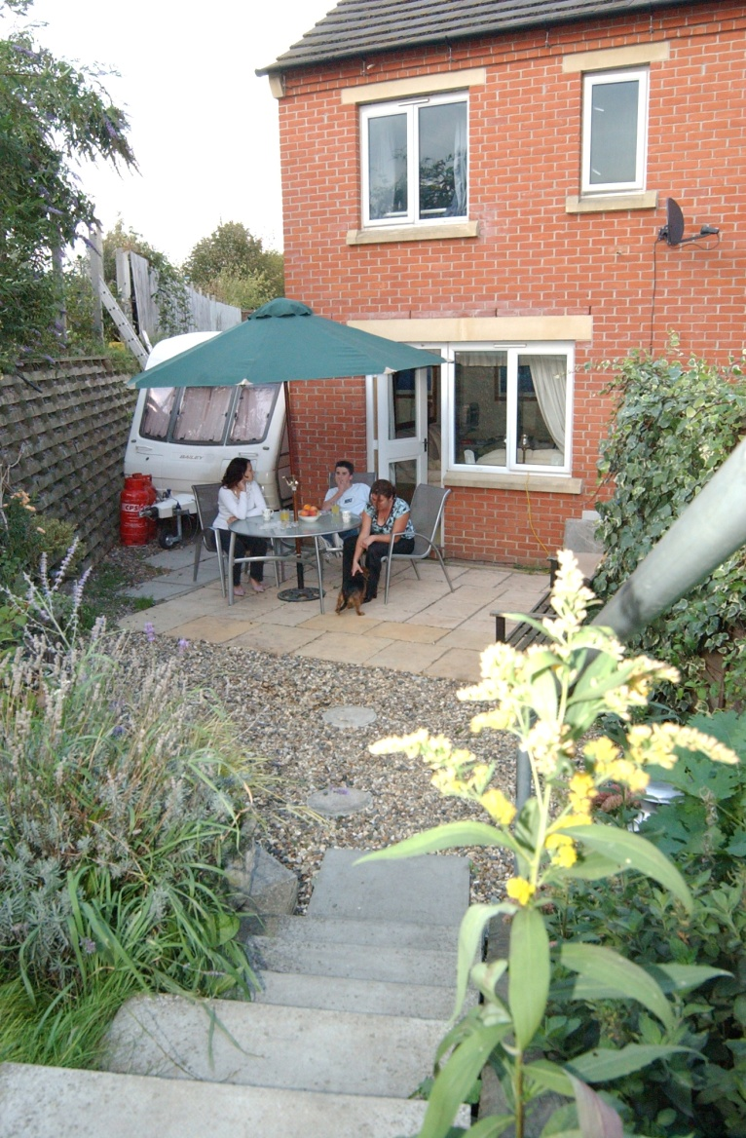
HOUSES
Many Gypsies and
Travellers now
live in houses.
Notes:
It is estimated that well over half of Gypsies and Travellers live in houses.

Slide 17
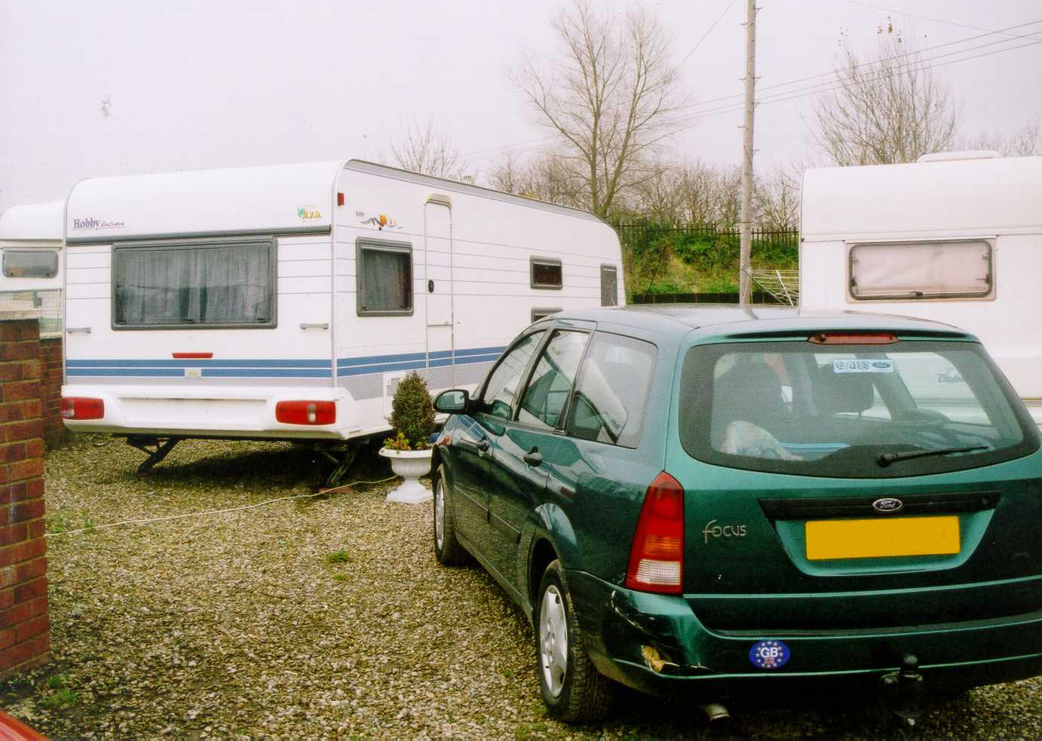
OFFICIAL SITES
Notes:
Council sites are often positioned where no-one else would choose to live and reinforces the ‘dirty Gypsy’ stereotype

Slide 18
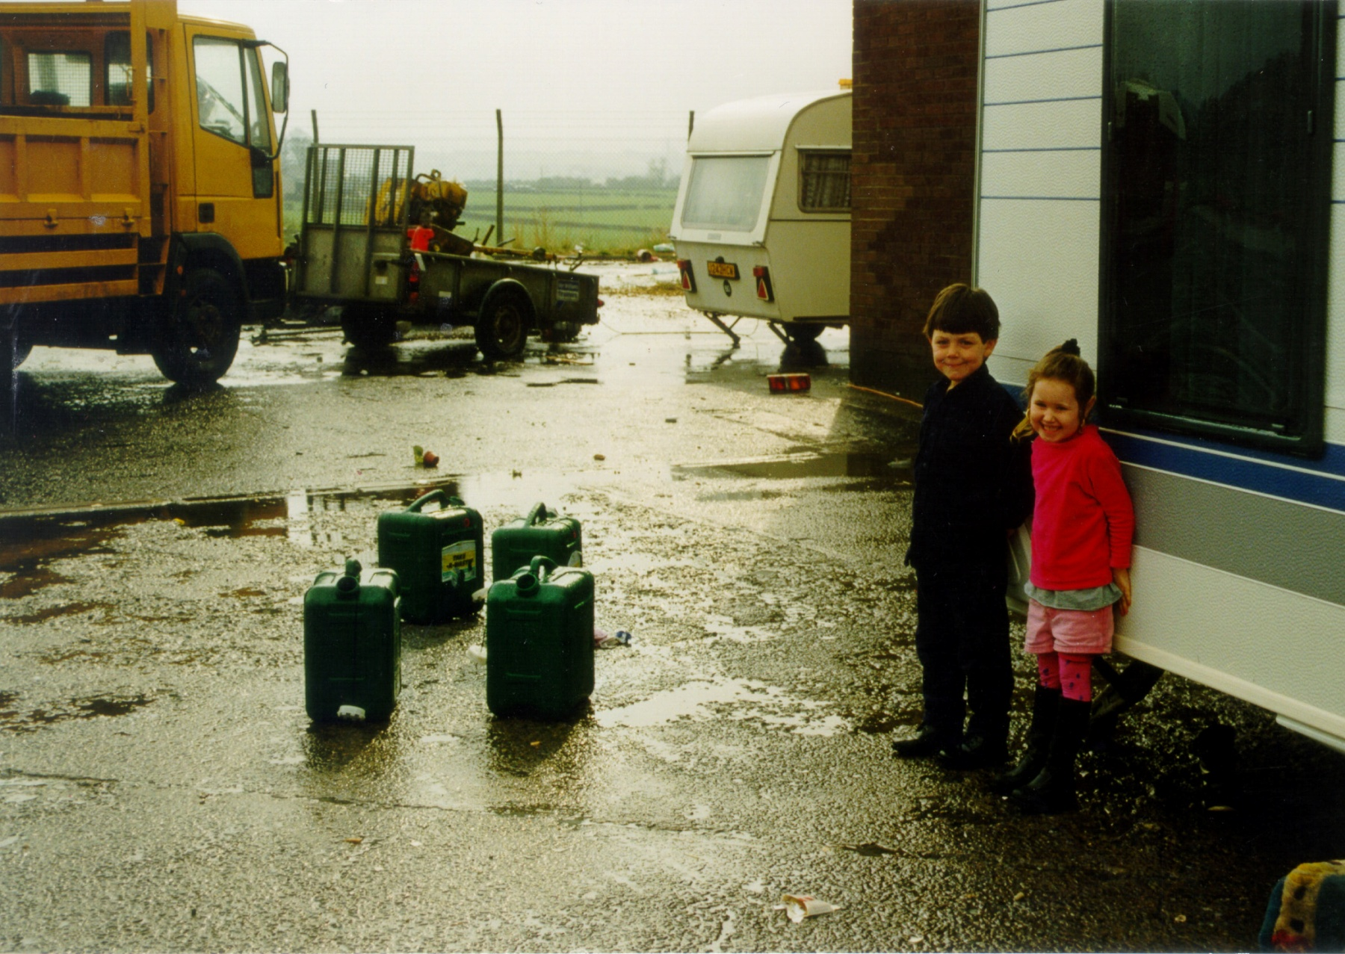
UNOFFICIAL SITES
Notes:
The most visible groups are those on unauthorised sites which may be on the roadside but this is a minority

Slide 19
SITE PROVISION
1968 Caravan Sites Act states that from 1970 local authorities should provide sites for Gypsies.
The 1994 Criminal Justice Act abolishes this, leaving 5,000 families with no legal home.
The 2004 Housing Act places a duty on local authorities to assess Traveller’s accommodation need and to develop strategies to meet that need.

Slide 20
WHERE TO LIVE
One fifth of the caravan-dwelling Gypsy
and Traveller population do not have an
authorised place to live, instead
occupying unauthorised developments or
encampments (Cemlyn et al, 2010).
Notes:
It has
been estimated that only one square mile
of land is needed to address the present shortfall of approximately 5000 pitches
(EHRC, 2009)

Slide 21
GYPSY AND TRAVELLER ACCOMMODATION
70% located in fringe areas of towns or villages
19% located in rural areas
11% located next to residential land
68% of sites are more than 1km from a primary school
55% of sites are more than 1km from a post office
38% of sites are more than 1km from public transport
There are currently available in England
341 local authority Gypsy sites with 5,074 pitches.
Only 6% are available as transit pitches.

Slide 22
OBSTACLES TO ADEQUATE PROVISION
Lack of adequate council and private sites
Lack of transit sites
Planning permission refusals
Existing sites are often located at a distance from common services and near to motorways, major roads, rubbish tips and industrial activity
Lack of security of tenure
Notes:
The government has estimated that between 1,000 and 2,000 additional residential pitches will be needed over the next five years.
Between 2,000 and 2,500 additional pitches on transit sites or stopping places will also be needed to accommodate nomadism.
Planning applications for Gypsy sites are refused in disproportionately high numbers compared to other planning applications. It is often the case that planning permission is sought retrospectively, that is made after the land is purchased and occupied. ACERT research finds that:
“For many Gypsies this route offers the only alternative to camping on the roadside. By buying and occupying their own land and applying for permission – even if refused – an appeal can offer valuable time and a chance of success. This method of provision is haphazard, costly and lengthy for both applicant and authority.”

Slide 23
Discuss what you have seen....

Slide 24
LESSON 3, PART 2 GYPSY & TRAVELLER HOMES
PHOTOGRAPHY

Slide 25
Note down the differences to your own
homes whilst you look at the photographs.

Slide 26
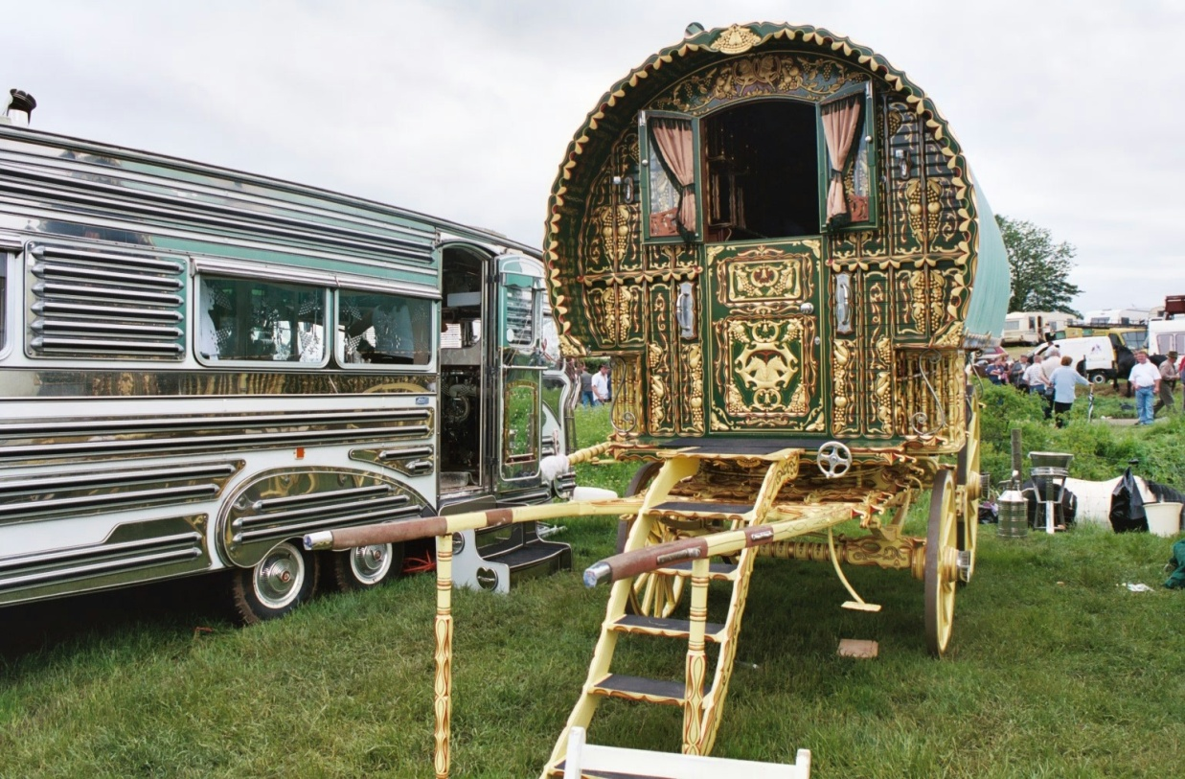
VARDOS

Slide 27
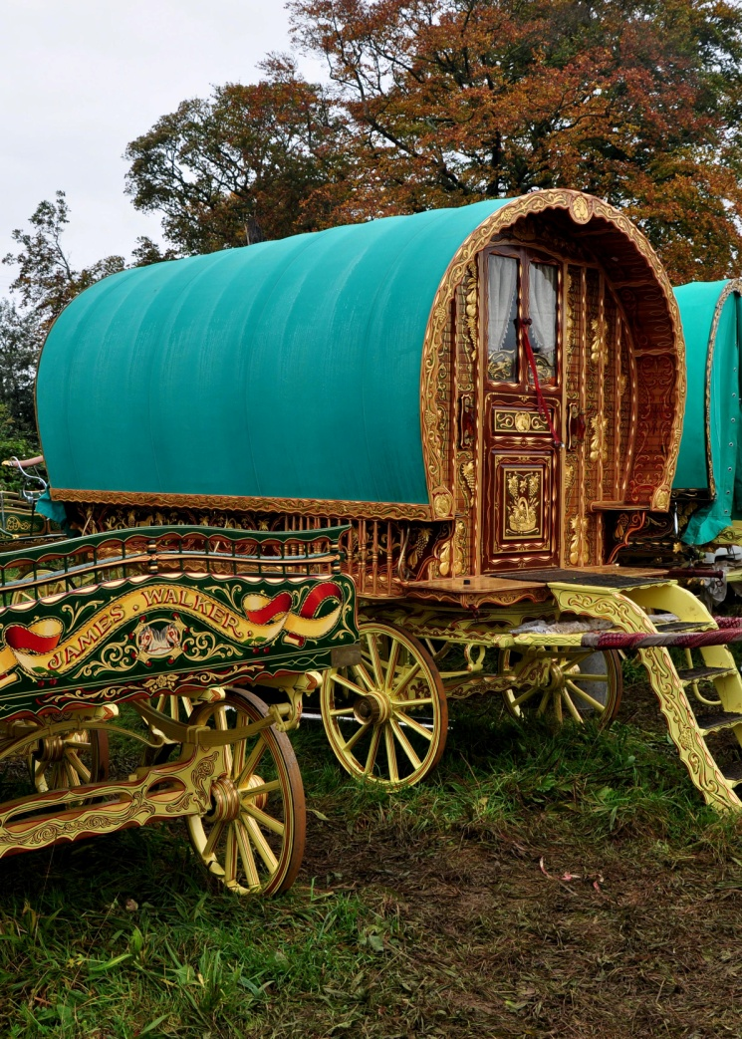
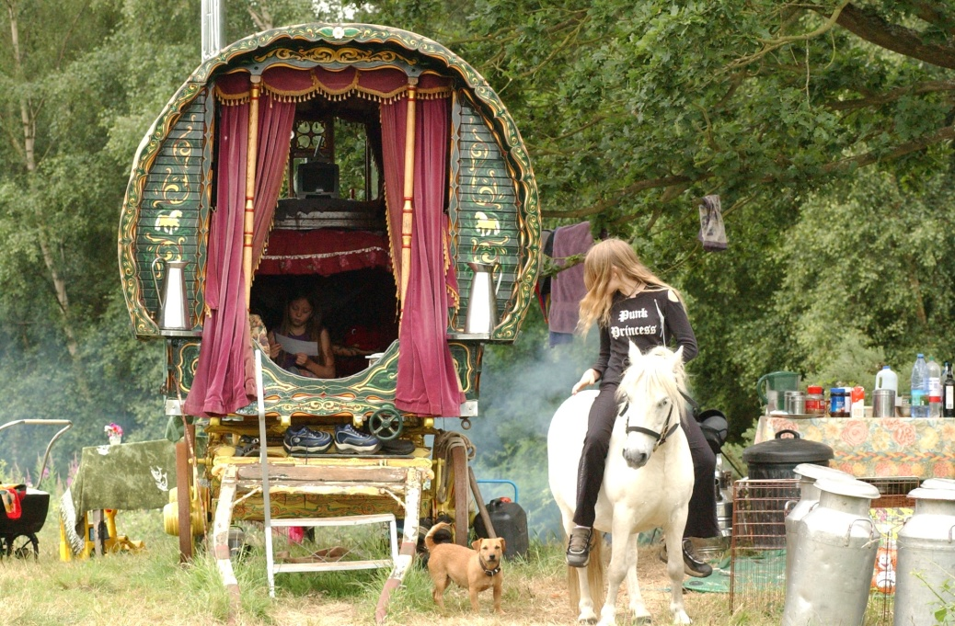

Slide 28
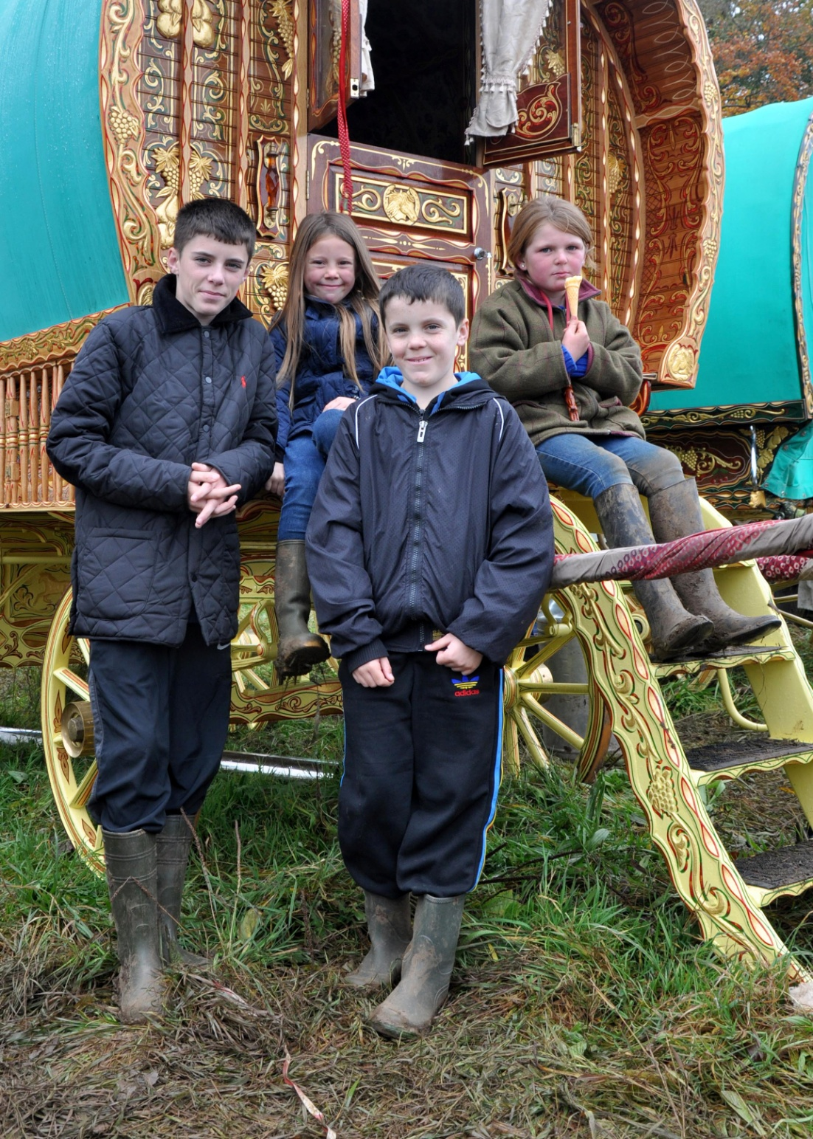

Slide 29
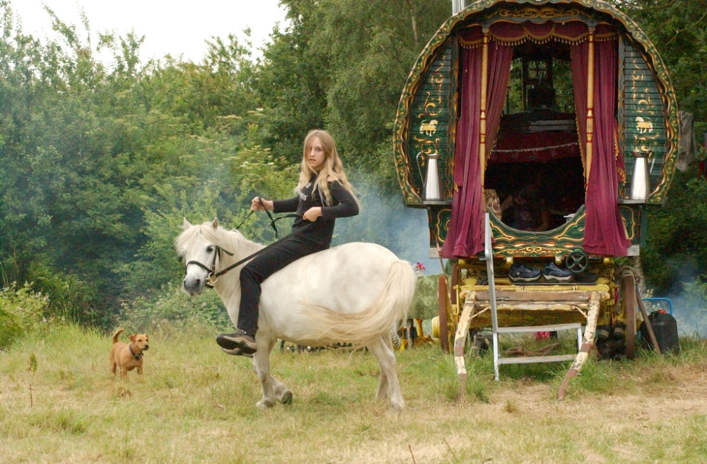
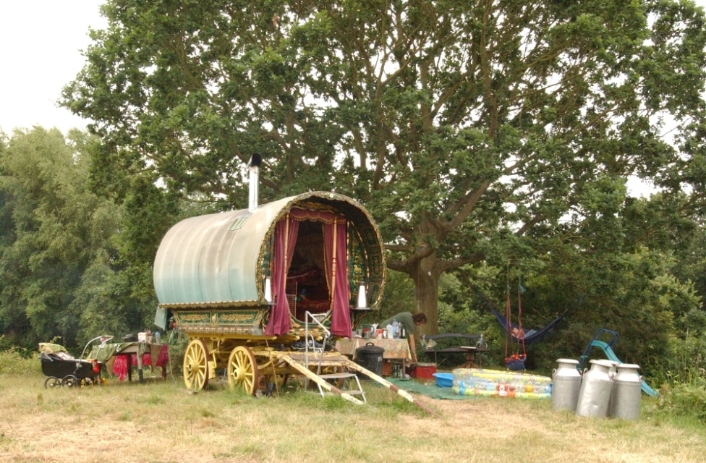
NEW TRAVELLER HOMES

Slide 31
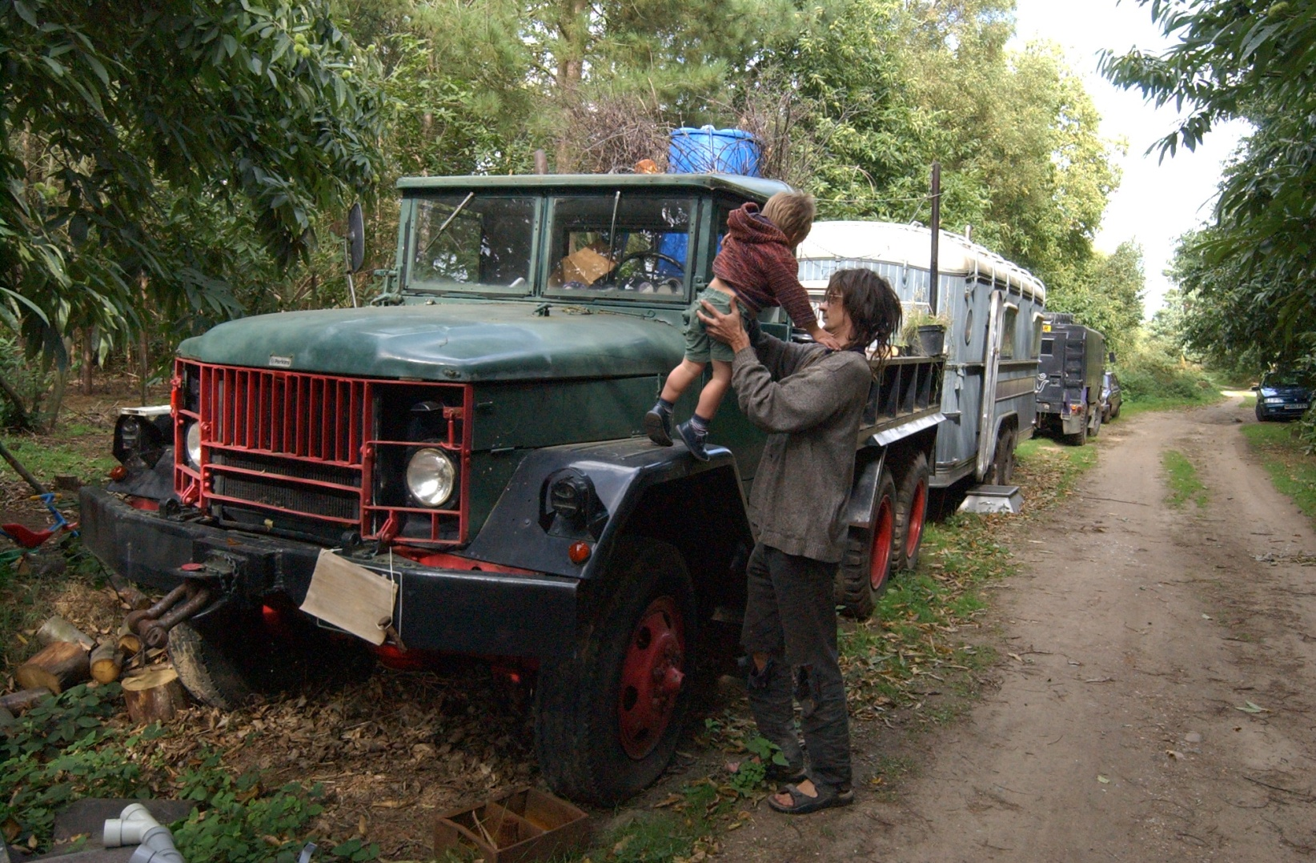

Slide 32
CIRCUS TRAVELLERS

Slide 34
GYPSY AND TRAVELLER HOMES IN LINCOLNSHIRE

Slide 35
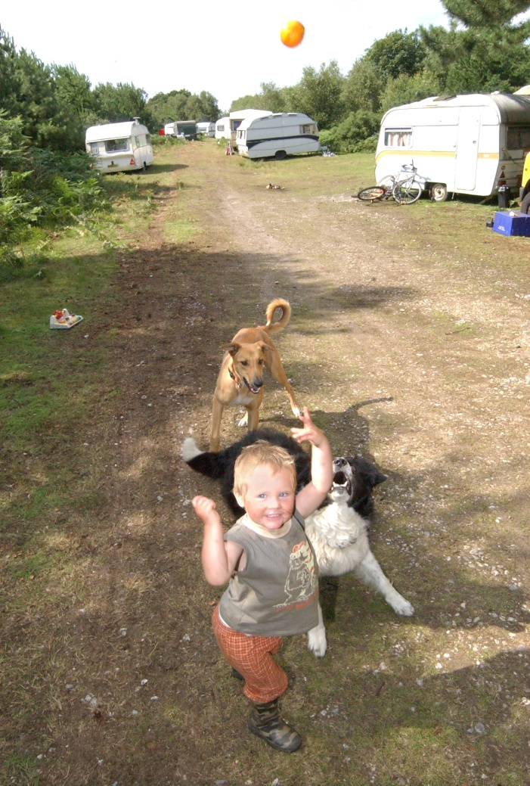

Slide 36
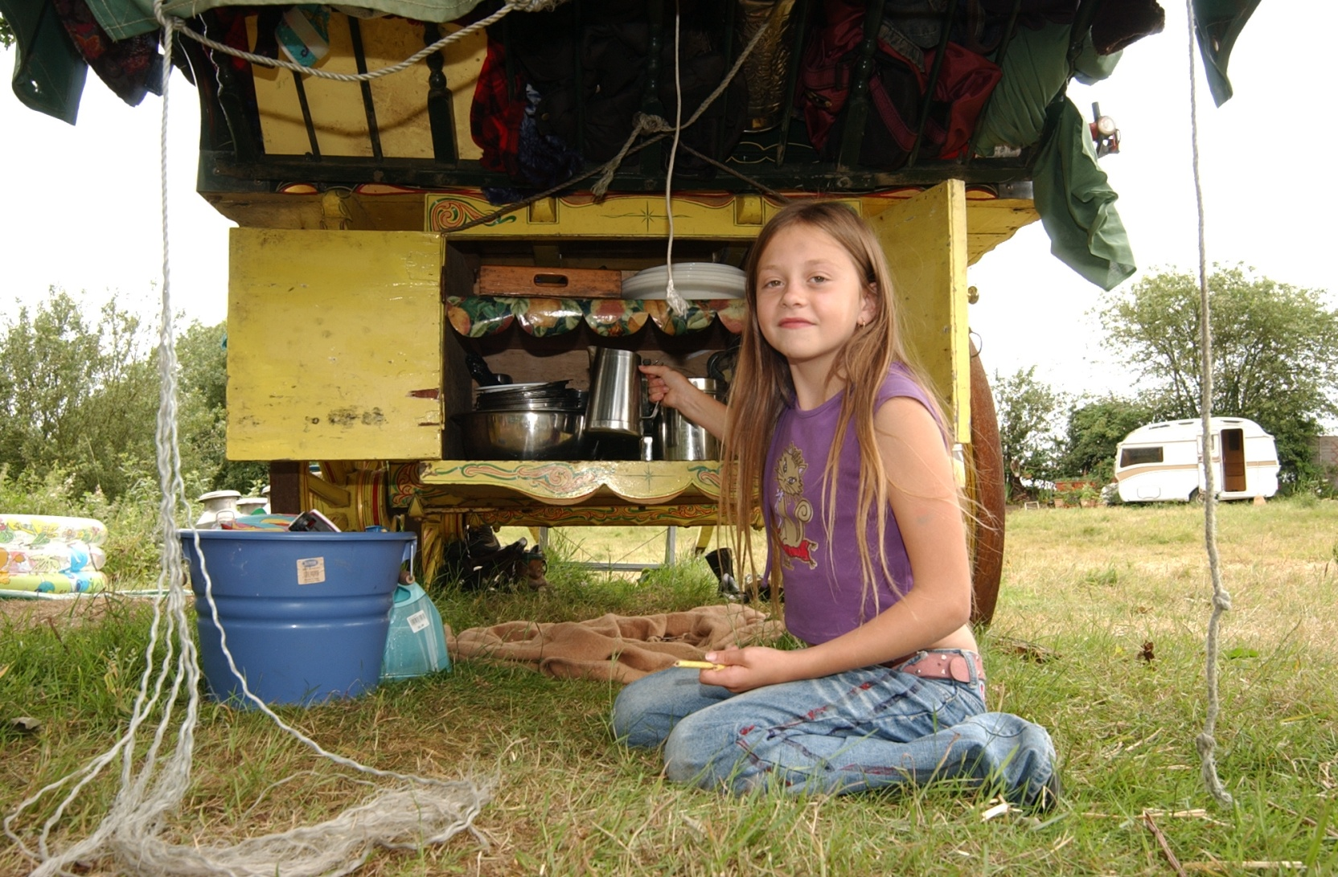

Slide 38
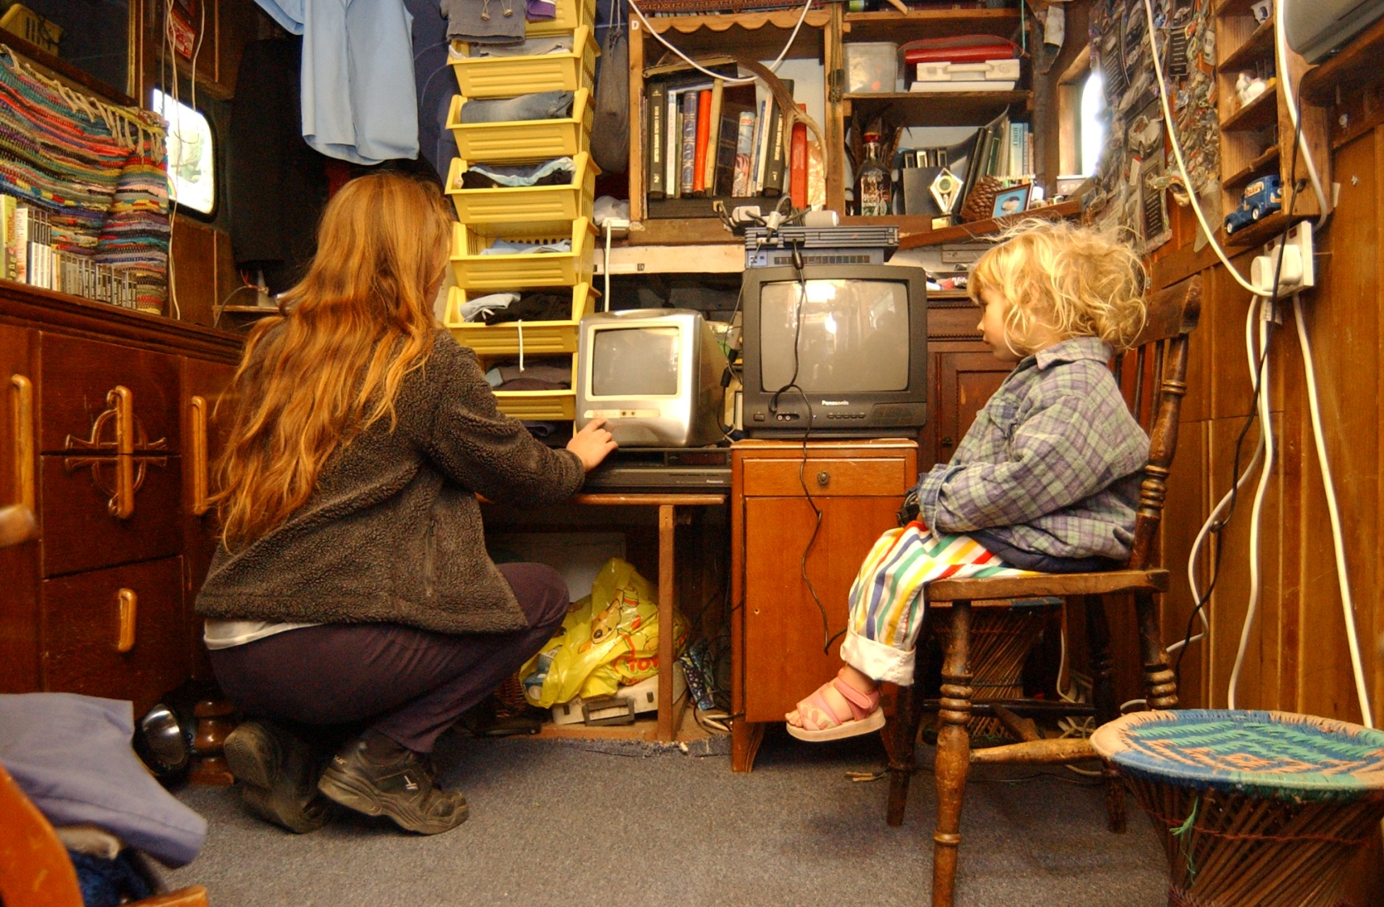

Slide 40
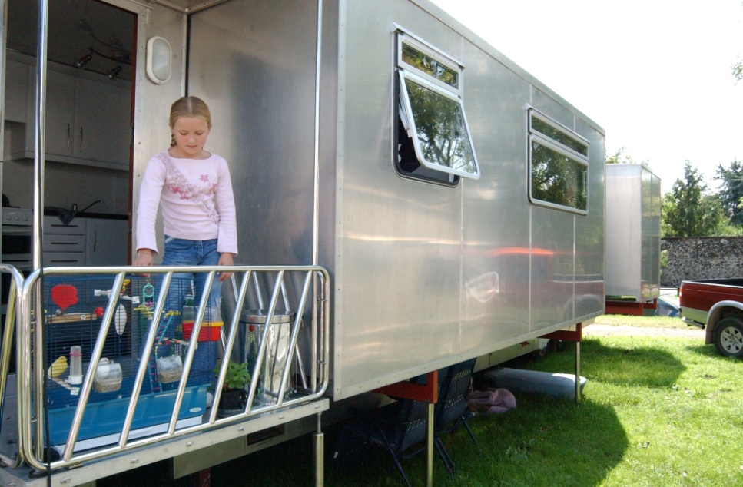

Slide 41
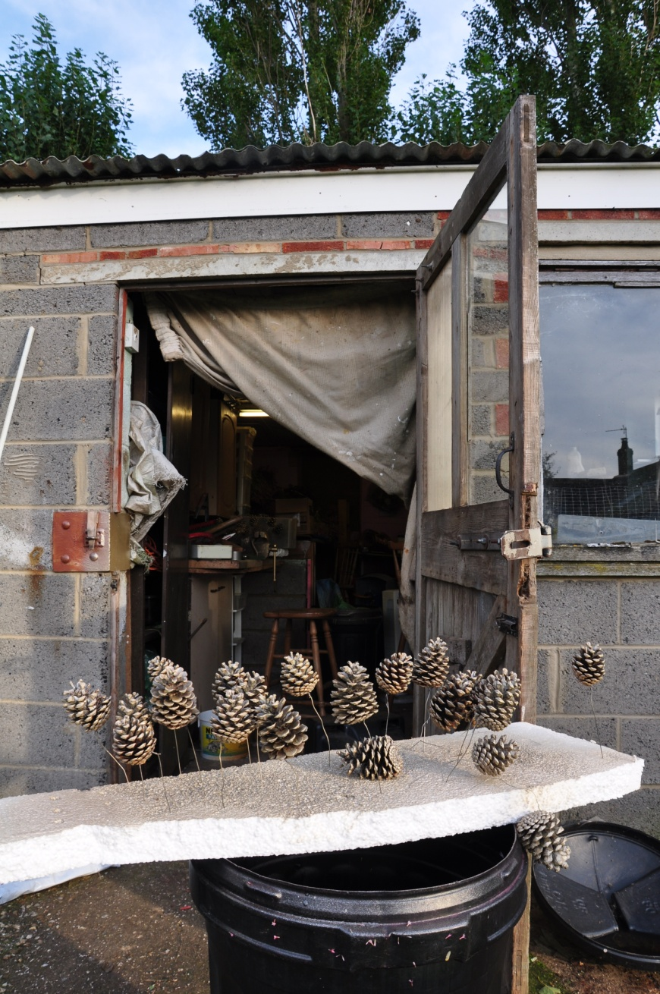

Slide 42
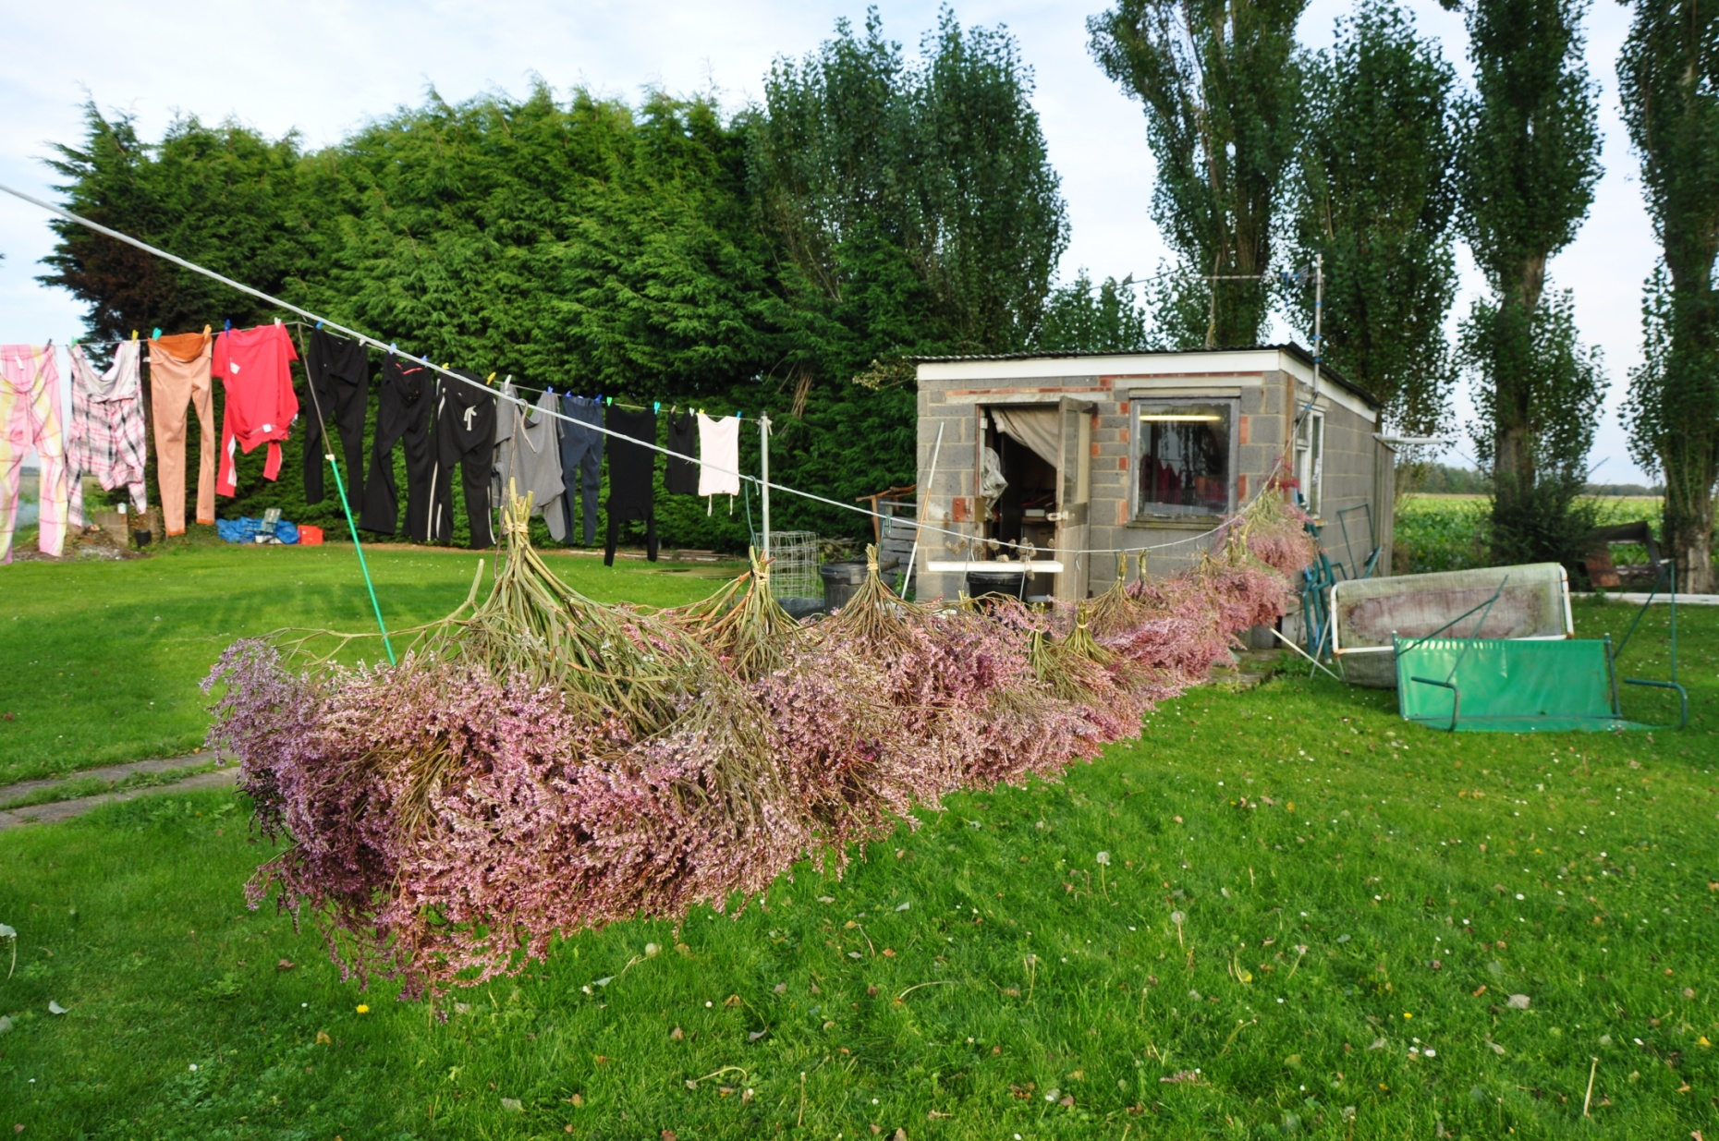

Slide 45
Feedback your notes to the teacher

