Slide 1
LESSON 1 HISTORY OF GYPSIES
AND TRAVELLERS

Slide 2
WHO ARE THE TRAVELLERS?
There are several main groups of Travellers in the
United Kingdom
Anglo-Romany Gypsies and Irish Travellers, Welsh Gypsies and Scottish Travellers
Fairground or Show people
Circus families
Boat people
New Travellers
Roma
Notes:
The phrase “Traveller Communities” is a generic term used to cover those identifiable groups, some of which have minority ethnic status, who either are, or have been traditionally associated with a nomadic lifestyle, and include:
Anglo-Romany (English) Gypsies & Irish Travellers, Scottish Travellers and Welsh Gypsies
Fairground families (or Show people)
Circus families
Bargee and other families living on boats
New Travellers
Roma – Gypsies with a heritage from mainland Europe
Additional information
Do we call them Gypsies or Travellers? Irish always known as Travellers. English were known as Gypsies for centuries – a corruption of their original name as “The Little Egyptians” as they were mistakenly thought to have come from Egypt. Last century many began to call themselves Travellers to escape the negative connotations associated with the term ‘Gypsy’. Then, in the 1960’s with the rise of the New Age Traveller movement, English Gypsies began to use the term Gypsy again to distance themselves from Irish Travellers, in consequence of higher levels of immigration and the negative media coverage of Irish and New Age Travellers. These days one would politely ask an English family if not sure whether to call them Gypsies or Travellers – they would not be offended by this as they would realise an understanding of their background and respect for their sensitivities.
DfES uses the term Gypsy, Roma and Travellers. The groups have their own distinct cultures and whilst some do not wish to associate with any of the other groups, there can be a certain amount of intermarriage between the different groups.
Now in the 21st century the Traveller community is probably one of the most excluded and marginalised groups in the UK.

Slide 3
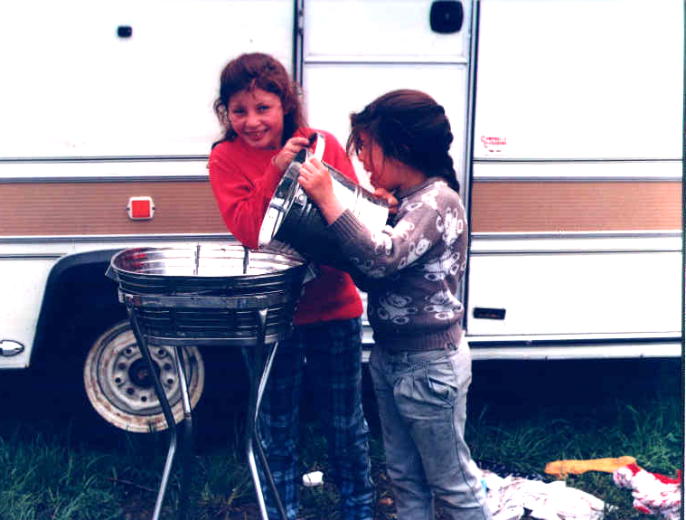
ROMANY GYPSIES, WELSH GYPSIES AND ROMA
Notes:
Romany (English) Gypsies
The word Romany derives from the Romani word Rom meaning ‘man’ or ‘mankind’.
It is the largest group of Travellers – estimated numbers of 200,000-300,000 in the UK.
This group has always been treated with hostility and suspicion.
They were sometimes tolerated for the services they provided e.g. trading and entertaining, but since 2nd World War there has been a rapid decline in traditional work opportunities and they have moved into other areas of work.
The 1994 Criminal Justice and Public Order Act criminalized the traditional Traveller way of life and took away the duty of Local Authorities to provide sites.
Welsh Gypsies
In 2002/03 the Welsh Assembly estimated the Gypsy population of Wales was 4,500.
They probably arrived in Wales during the 16th Century, the first record was in 1579 and refers to the arrest of Gypsies in the then county of Radnor.
Many of the Welsh Gypsies have moved into houses, others continue to lead a nomadic lifestyle.
The caravan dwelling population of Wales today includes Irish Travellers.
In South Wales they are frequently descendants of inter-marriages between England and Welsh Gypsies
Roma
It is estimated that there are 12 million Roma/Gypsies/Travellers living in Eastern and Central Europe.
Some have come here seeking asylum – there is large scale persecution of them in most eastern European countries.
In many countries it is only recently that Roma have been allowed to attend mainstream schools, they were segregated into special schools as mentally unfit to learn, or schools with 100% Roma pupils located in Roma ghettoes.
There has not been the ‘flood’ of Roma into this country that was forecast when accession countries joined the EU earlier this year.
There is probably a 3% higher number of Travellers in the UK who retain a nomadic or semi-nomadic lifestyle compared to other European countries.

Slide 4
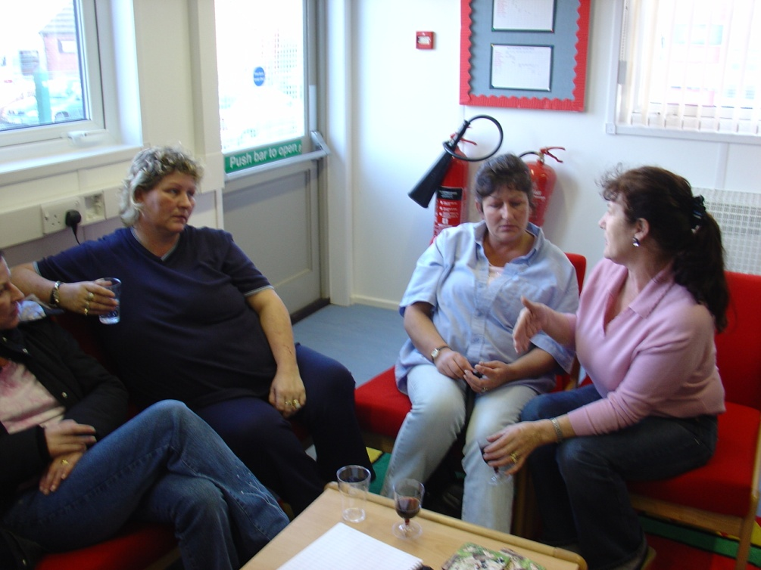
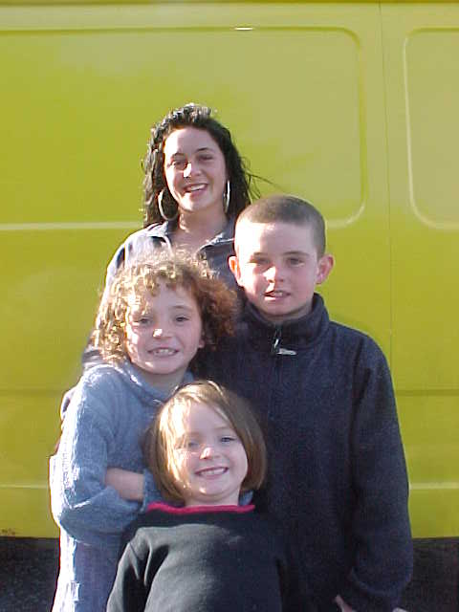
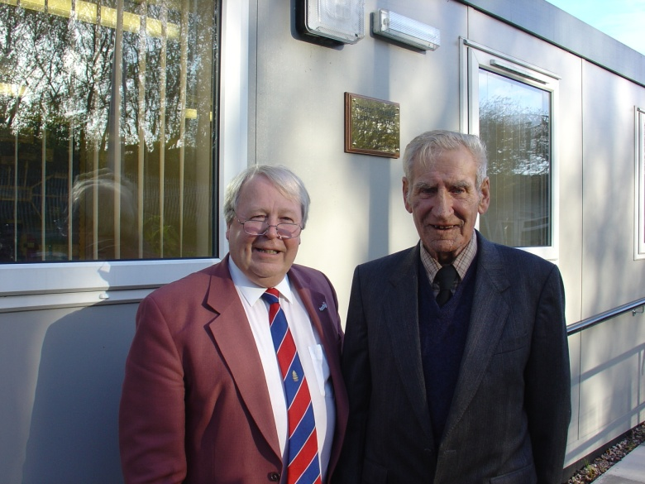
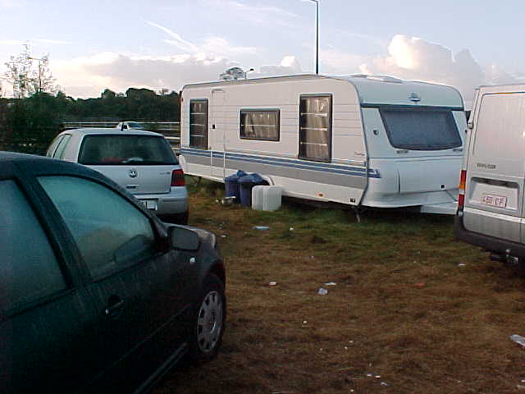
IRISH AND SCOTTISH TRAVELLERS
Notes:
Irish Travellers –
Descendents of itinerant craftsmen and metal workers known as Tinkers (now considered a derogatory term),
History of inter-marriage with Gypsies as evidenced in the % of Romani words in the language of Irish Travellers (Gammon).
Descended from wandering musicians and story tellers.
Families dispossessed of their homes during Cromwell’s oppression
Potato famine in 1845 led to increase in nomadic lifestyle
1963 – Policy in Ireland forced Traveller families into housing which led to migration to England.
Those Travellers from Ireland who have been settled in the UK are defined within the Race Relations (Amendment) Act as Travellers of Irish Heritage.
Scottish Travellers
Similar origins to Irish Travellers
Travelling metal workers were recorded as early as 12th Century
Land clearances in 18th and 19th century dispossessed people who took to nomadic way of life.
Intermarriage with Romany Gypsies may have occurred earlier in Scotland than Ireland – first record being 16th Century.

Slide 5
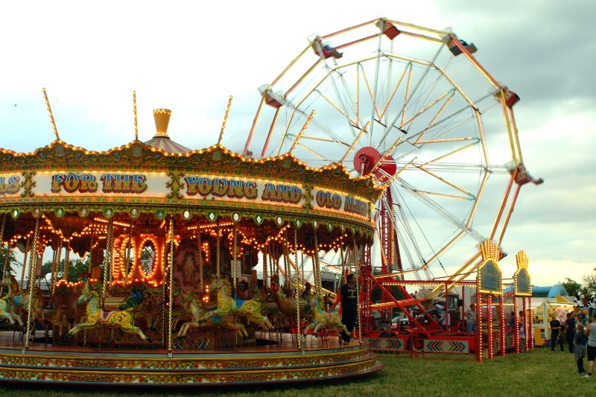
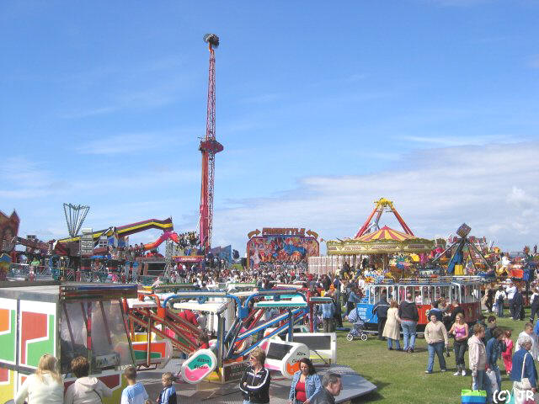
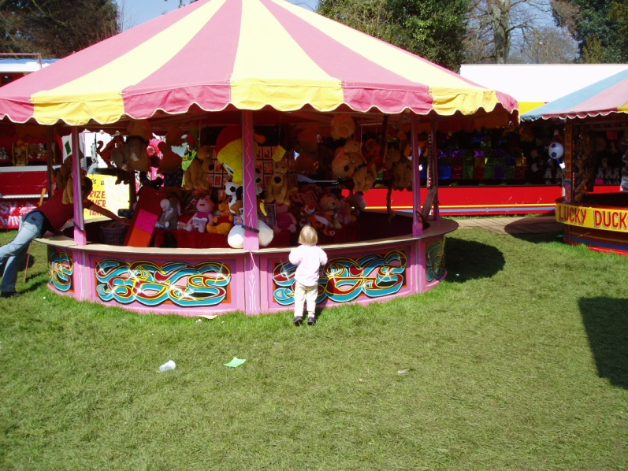
FAIRGROUND FAMILIES
Notes:
Showmen are Travellers who work with circuses and travelling shows.
Like Gypsies and Travellers, Fairground families have a strong tradition of passing skills on to their children.
The Showmen’s Guild is the representative body for travelling Showmen who gain their livelihood by attending Funfairs. It protects the interest of their members in two ways: by its code of rules and advice and guidance on legal requirements for travelling fairs. Members of the Guild are called Showmen and are normally the owners of fairground equipment. Families usually own the rights to hold fairs and let pitches to others. They may employ non-fairground labour, known as ‘Gafflads’
The number of fairs fluctuate annually. They are not as economically viable as they used to be – due to competition from theme parks.
Families tend to be highly organised and have specific travel patterns. This usually involves residence at a winter base during the closed season, between November and February. Children therefore normally return to a winter-base school during this period.
It is usual for a Fairground youngster to travel during the summer season with Distance Learning work provided by their base school. There is also growing interest in the development of E-learning for pupils on the move.
Arrangements for sending work back to school and updating work packs may be arranged by base schools, parents or Traveller Education Services. Some Traveller Education Services provide on-site support to youngsters at some visiting fairgrounds.

Slide 6
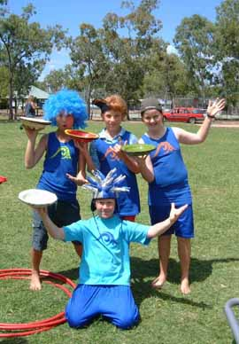
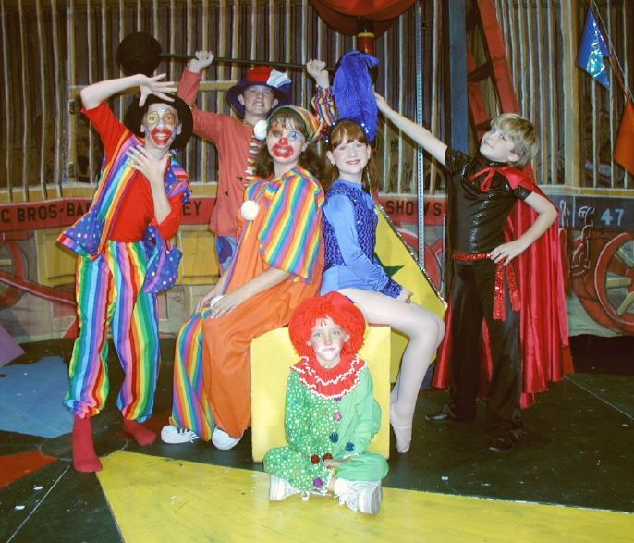
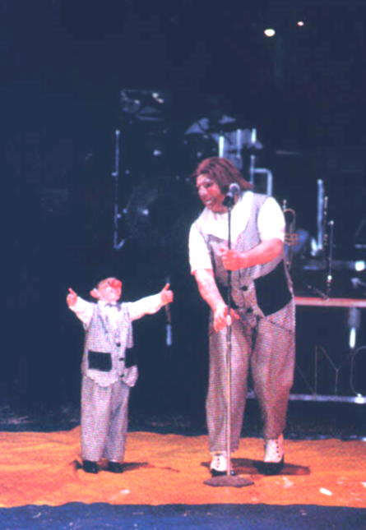
CIRCUS FAMILIES
Notes:
There have been forms of the circus since the days of ancient Rome where animal and athletes displayed their skills in amphitheatres such as the ‘Circus Maximus’. The ‘modern’ circus originated in Britain in 1768 when a cavalryman, Sergeant-Major Philip Astley, roped off a field in London for his fancy riding exhibition. As the show became popular he roofed over the ring and added clowning, tumbling and juggling between the equestrian acts. Thus the size of a circus ring, 42 feet in diameter, was dictated by the galloping circle for a horse and modern circus began. Astley established 18 other circuses in European countries. Travelling circuses probably originated in America after the war of 1812 and soon became popular in other parts of the world. In recent years public attitudes to performing animals has changed and many circuses now do not have any animals in their shows but have instead developed into theatralized shows which mixes the arts of the circus and the street, and features original music, light effects and costumes.
Circuses tend to be owned and administered by a single family – the Circus Proprietor - who then hire a range of acts, often from abroad, to make up the repertoire for the yearly circuit. A group of children travelling with a circus may often be multi-national and so English may not be the first language for many.
Travelling patterns may vary from static seasonal circuses (eg. Blackpool Tower) to small circuses that move every couple of days. Many circuses have an annual pattern of travel which precludes attendance at a base school, whilst static seasonal circus children are likely to attend a local school during the season.
Attitude to education may vary. Whilst education may be a high priority for all groups, some parents will place their children in school for very short periods wherever they stop eg. Moscow State, Chinese State, Spirit of the Horse, but others consider it less traumatic for their children to receive on-site support from Traveller Education Services.
The highly mobile nature of the travelling circus has led to the development and use of ‘the Red Book’, a parent held record of personal learning targets and achievements which is completed at every school the child attends. This aids in combating the assumption that may be made that these children who are attending a different school every week are behind in their education. These children often easily adapt to their changing learning environments.

Slide 7
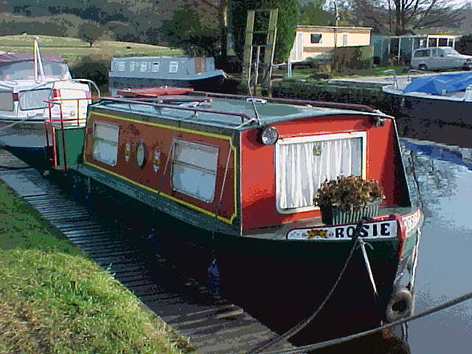
BOAT FAMILIES
Notes:
There are many theories as to where the canal boatmen or bargees came from. Some people believed the boatmen were Gypsies who took to the water but this is certainly untrue.
The development of the canal network in the eighteenth century brought with it the opportunity of well paid jobs on the working barges so probably many boatmen were from the villages alongside the canals who desired a new way of life. They soon established a unique community with a way of life, language and customs of its own. They were sometimes disliked and mistrusted by people of the land.
The decline of the canal industry in the twentieth century led to the loss of this work and lifestyle.
Today many narrow-boats have been converted into living accommodation and families are choosing to live and travel on the canals.
There appear to be a small number of children living on the canals who usually attend a local school.

Slide 8
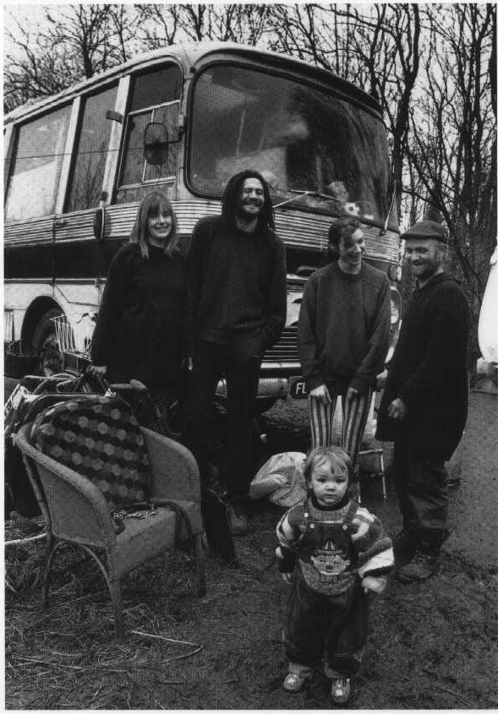
NEW TRAVELLERS
Notes:
The term New Travellers refers to a growing community of people from a range of cultural and social backgrounds that have taken up a nomadic way of life over the last 40 years.
The reasons that non-traditional Travellers take to the road are usually the result of economic, social or personal pressures.
In order to restrict the travelling patterns of New Travellers, such as large convoys gathering for music festivals, the 1994 Criminal Justice & Public Order Act was brought in and this criminalized unauthorised camping by all Travellers.
There are small numbers of New Traveller children entering mainstream education as often their parents have chosen an alternative lifestyle and wish to educate their children themselves.

Slide 9
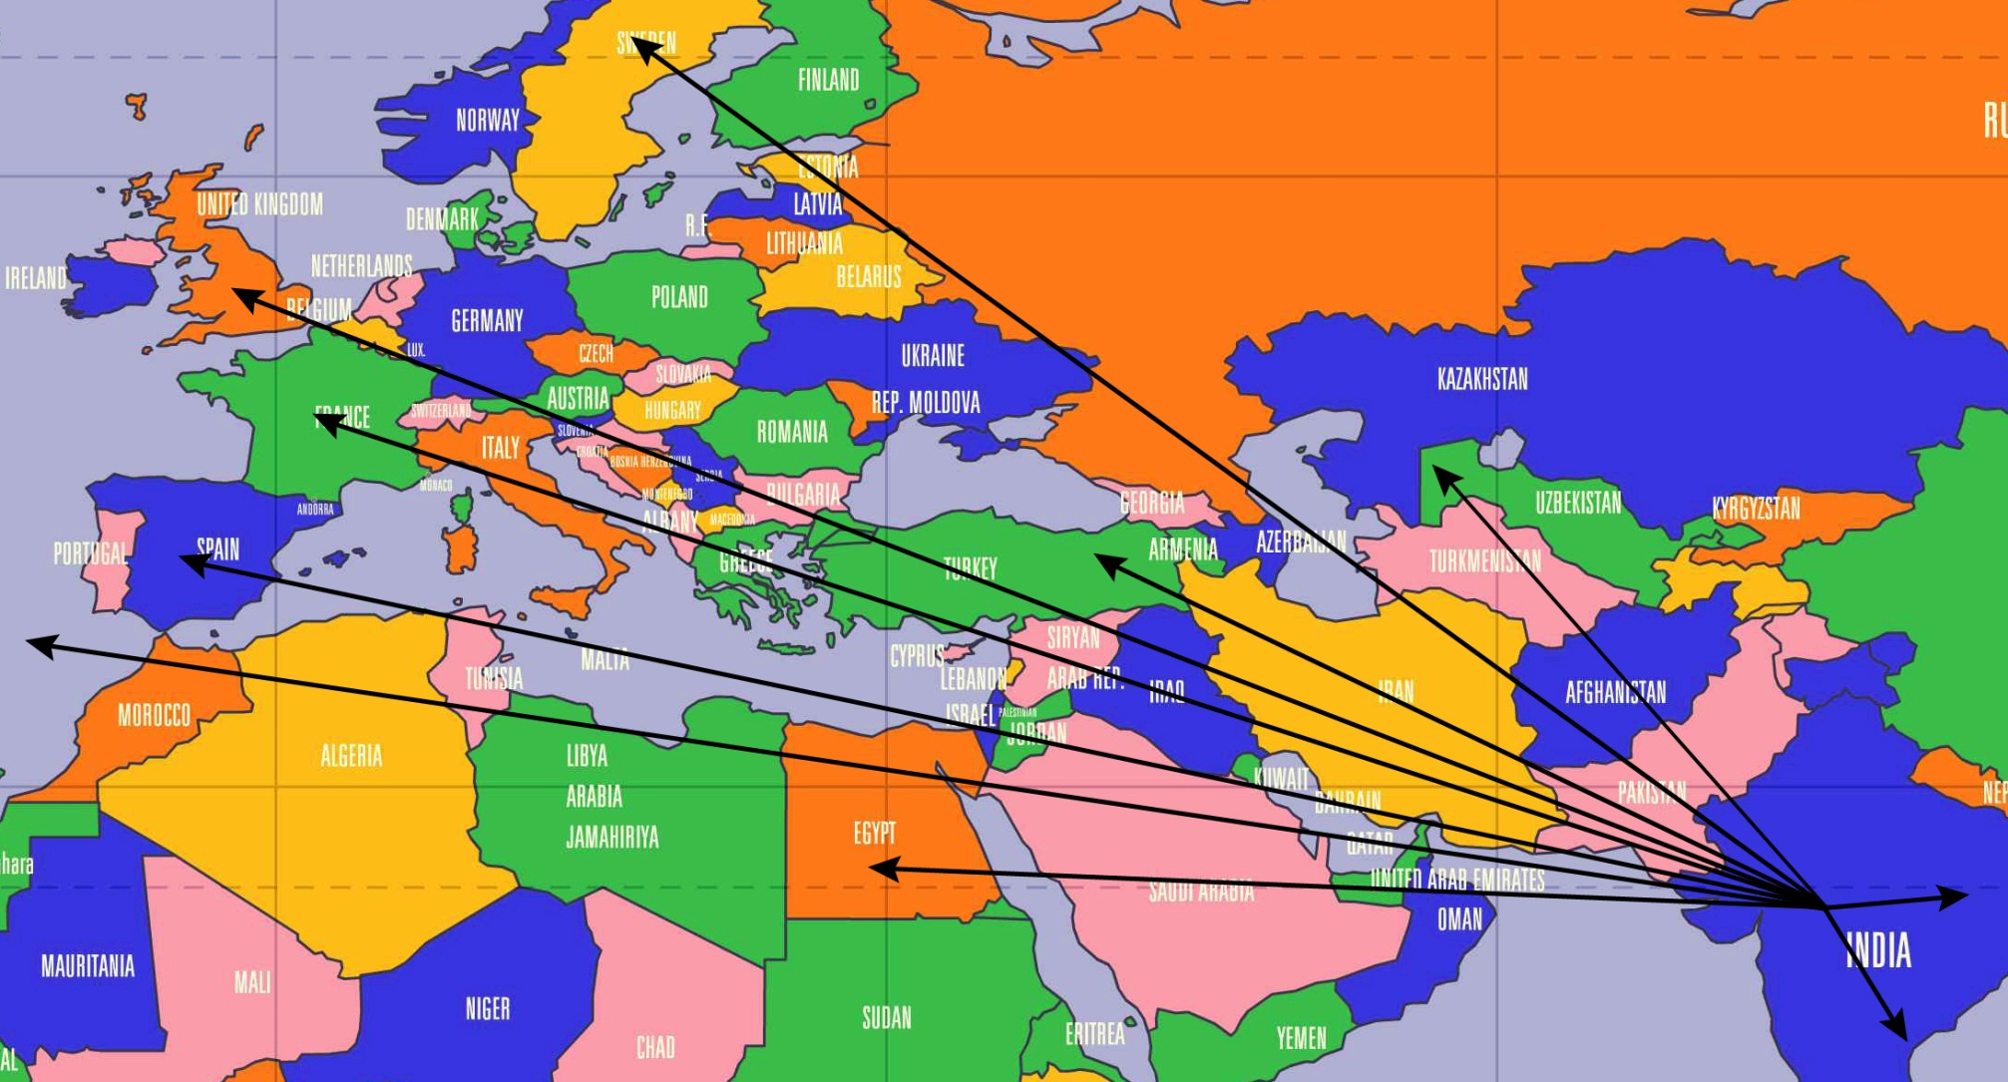
GYPSY FAMILIES TRAVEL FROM INDIA 500 YEARS AGO
Notes:
It is believed that Gypsies originated from nomadic tribes in North West India.
This knowledge comes from their language – Romani – which is closely akin to the dialects still spoken in that area. (English Gypsy families here sometimes still speak Romani at home).
It was not one massive migration but probably movement of large family/tribal groups moving to look for work or fleeing clashes between invading Arab and Mongolian warriors. They trekked across east and west Europe and settled in every region from Persia to the Balkan states.
The first written record of them in UK was in Scotland in 1505, so they had probably arrived here some time before that.

Slide 10
1505 - GYPSIES ARRIVED IN ENGLAND
Notes:
Gypsy pilgrims arrive, probably from Spain
Parish records from around this time show that Irish Travellers are already living in England.

Slide 11
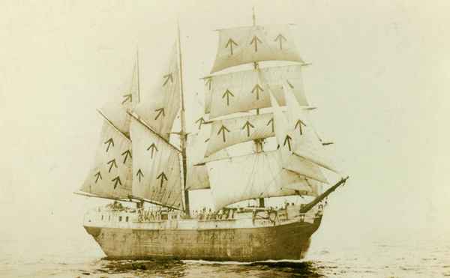
Notes:
1530 Gypsies are forbidden to enter England under Henry VIII. Those already there are deported.

Slide 12
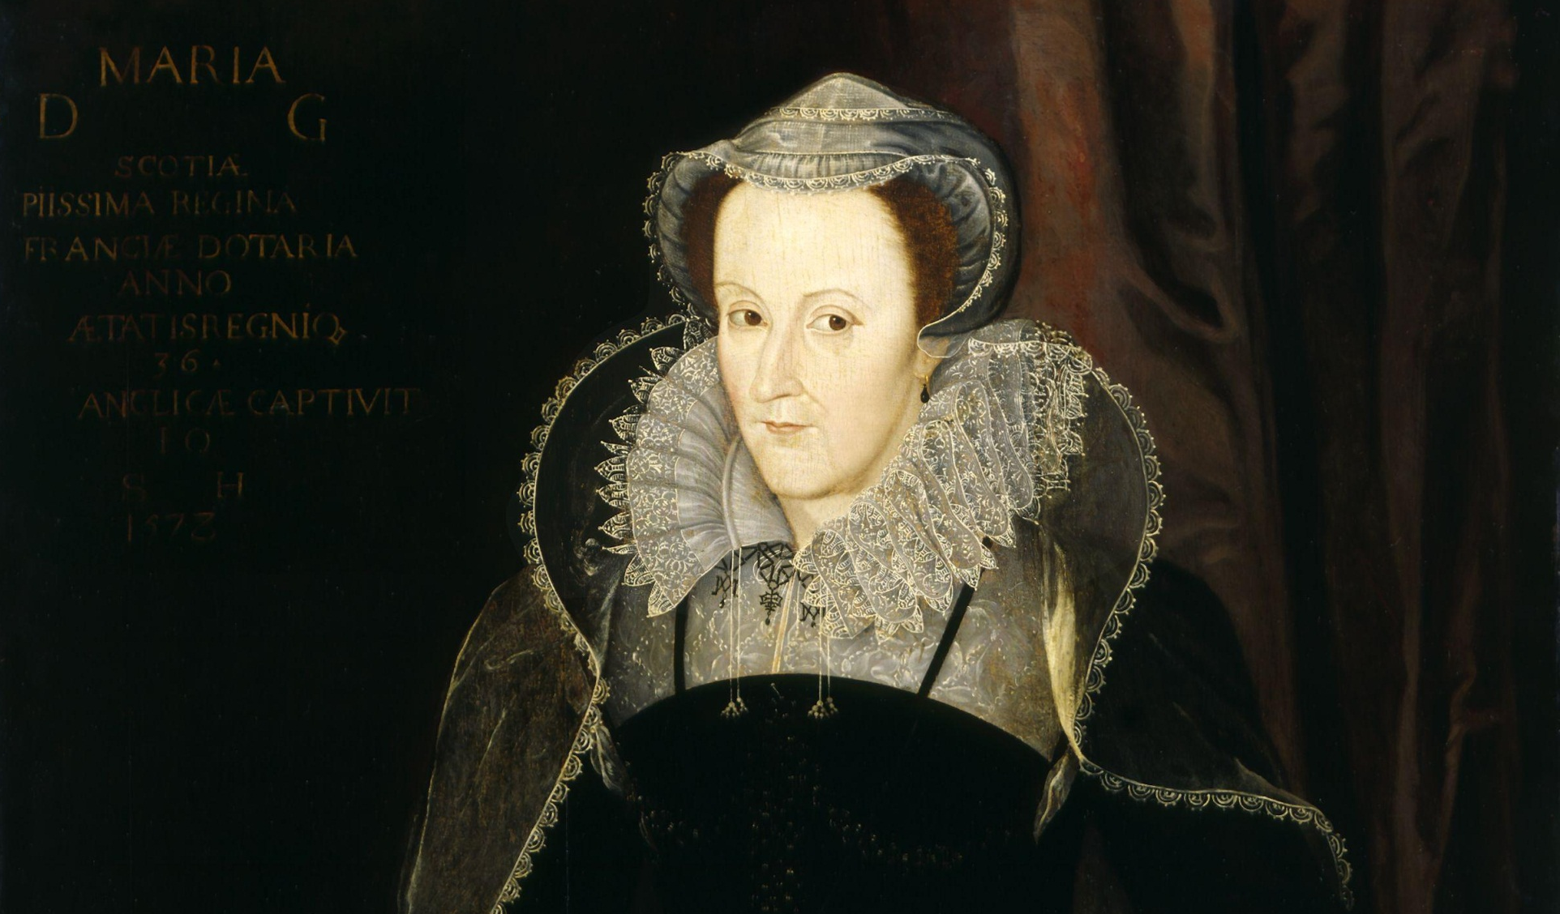
QUEEN MARY
Notes:
1554 Queen Mary of England passes the Egyptians Act. Being a Gypsy is punishable by death, as is being found in “the fellowship or company of Egyptians”. This is the only time that fraternizing with an ethnic community has been punishable by death

Slide 13
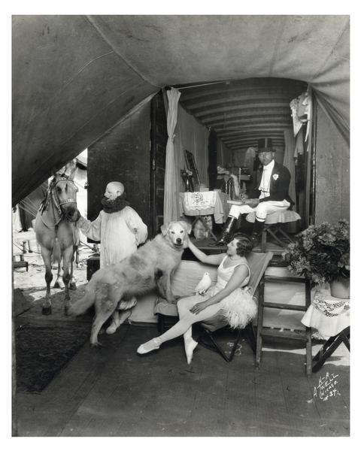
MODERN CIRCUS
Notes:
1768
The first modern Circus is held in London.

Slide 14
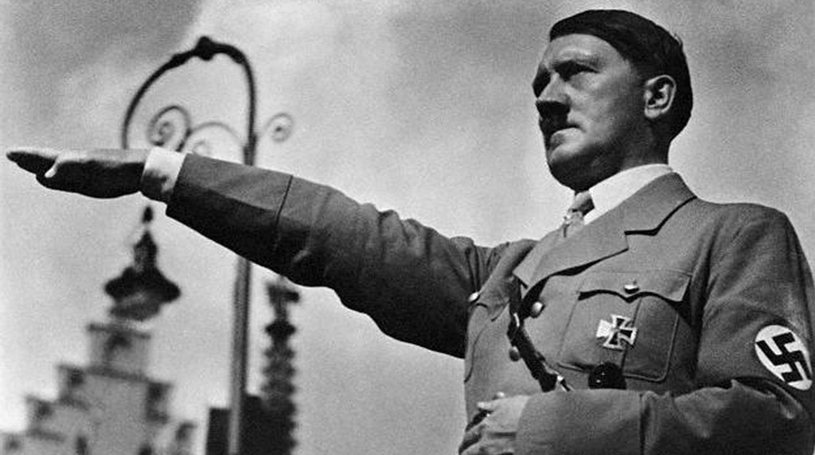
WORLD WAR II - ADOLF HITLER
Notes:
World War II. Nazis compose lists of English Gypsies to be interned. In Britain, the government builds caravan camps for Gypsies serving in the forces or doing vital farm work. These are closed when the war finishes. Gypsies are stripped of all human rights by the Nazis

Slide 15
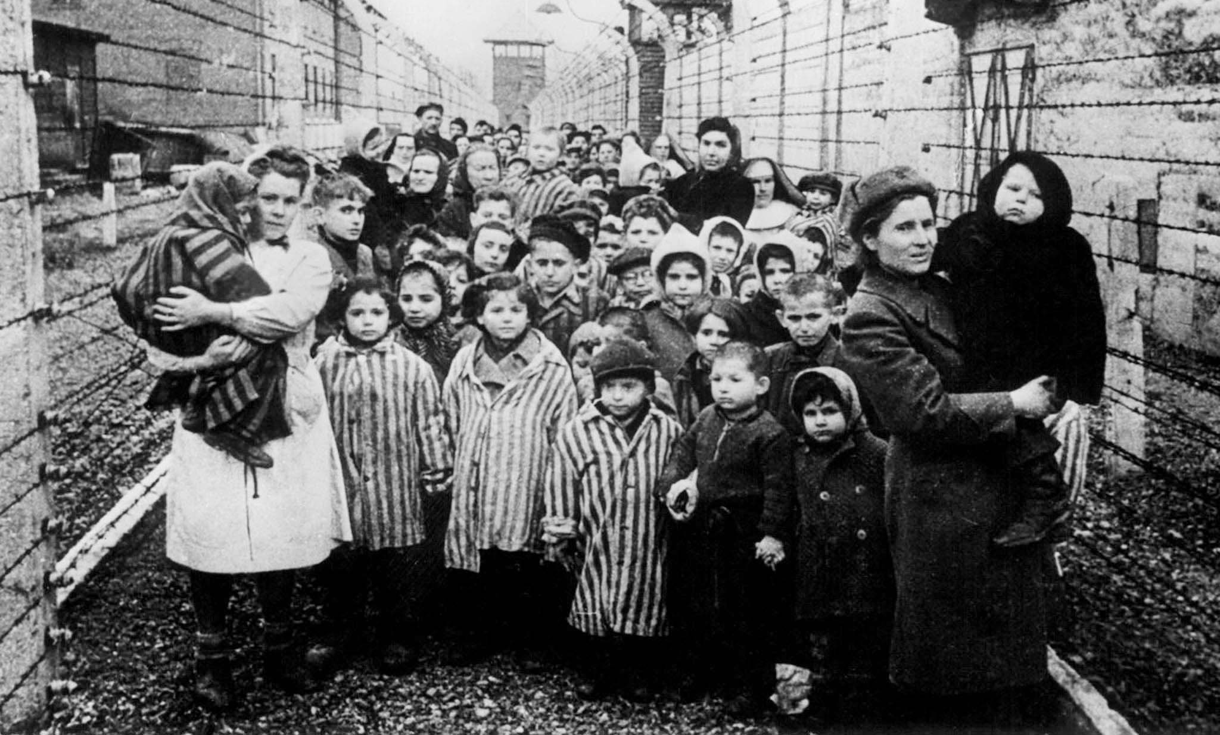
Notes:
As many as 600,000 are murdered in camps and gas chambers.

Slide 16
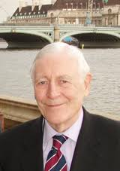
1968
Lord Avebury helps to pass the new
Caravan Sites Act. From 1970 the
Government has to provide caravan
sites for Travellers

Slide 17
NEW LAW
Race Relations Act 1976
Gypsies and Irish Travellers
are protected under this law
Updated in 2000

Slide 18
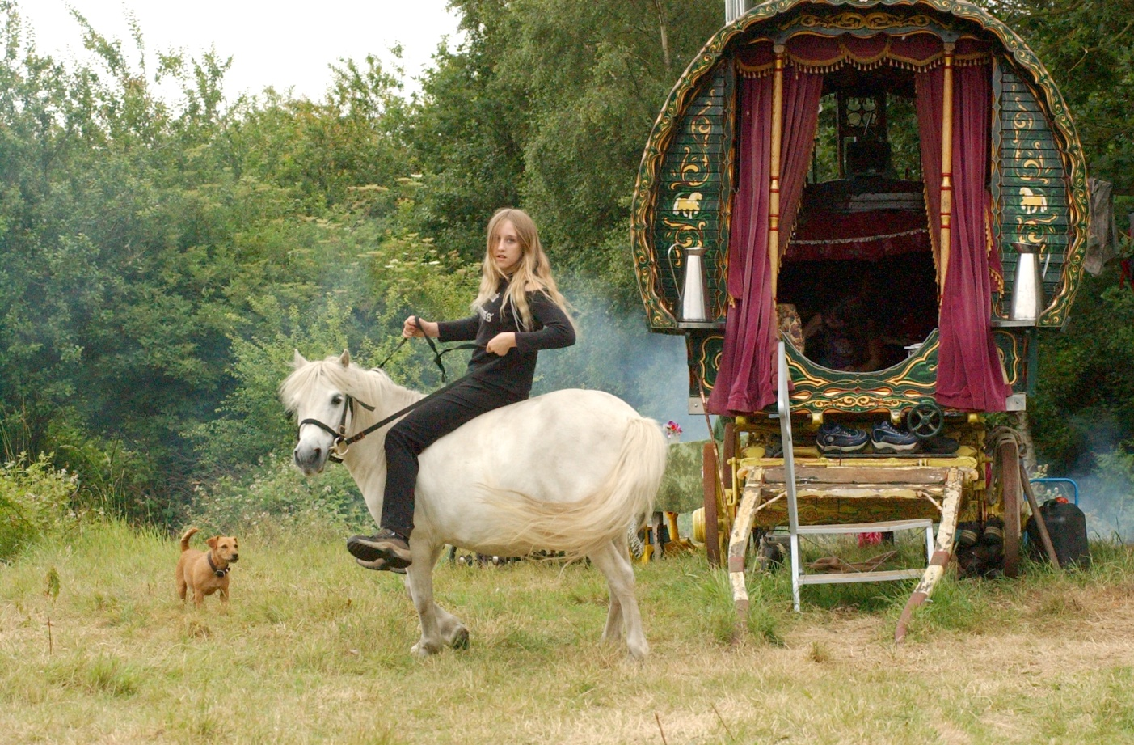
NEW TRAVELLERS
Notes:
1970s-1990s
People from the settled community start to take to the road and live in caravans. They are known as “New Age Travellers” in the media

Slide 19
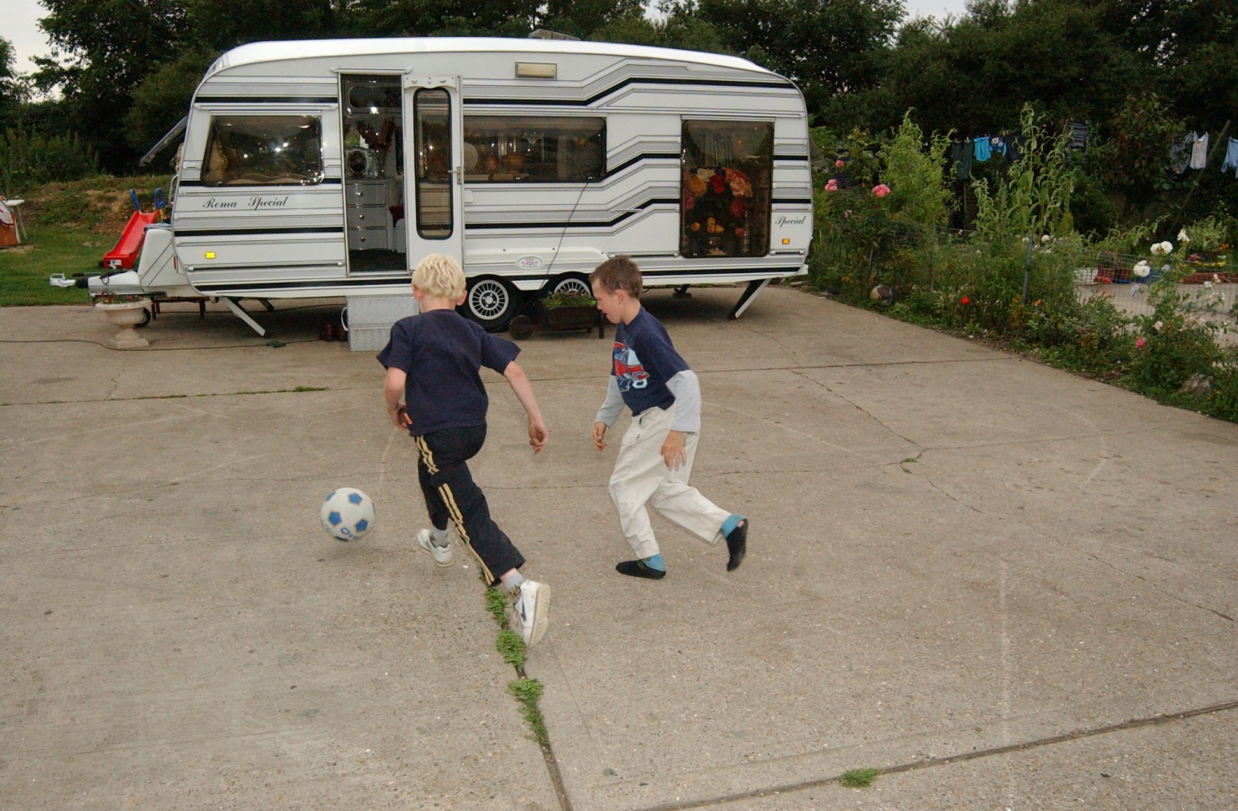
1994
Notes:
1994
The Criminal Justice and Public Order Act abolishes the Caravan Sites Act. This is disastrous for all Travellers living in Britain, and more than 5,000 families now have no legal home. Local councils became duty bound to identify land for private purchase by Travellers. Not one local council adhered to this.

Slide 20
ROMANY WORDS
Kushti
Nice, good
Holler
Shout
Frit
Frightened
Ladged
Embarrassed
Mush
Man
Mokkadi
Unclean
Chavvi
Boy, Son

Slide 21
LANGUAGE
Romany Gypsies - Romani
Irish Travellers - Gammon
Scottish Travellers - Cant
Romani contains words from Persian, Greek and many other Eastern and Western European languages. A high proportion is still of Indian origin. Romani derives from ancient Sanskrit.
Notes:
Some groups have their own distinct language but all groups use specific terms to identify non-Travellers for example:
Anglo-Romany - Gorgio, Gadjes, Gauges
Irish Travellers - Country folk
Fairground - Flatties
Most Romany Gypsies in this country have retained elements of a language known as Romani – which has its origins in ancient Sanskrit.
Many now use a mixture of English and Romani which is spoken rapidly and usually used as a community language called Anglo-Romany
Cant (Scottish) and Gammon (Irish) – in the past the differences in the three languages was clearly defined from as far back as the 13th Century. Believed to be the language of Irish poets and scholars. Shelta is more similar to English that the Irish Gaelic.
The Romani language may have been in decline in the last few decades, but many commentators indicate that there appears to be something of a revival occurring alongside an increase in cultural pride.
Many Romani words have become an accepted part of the English language, for example:
kushti - good
frit - frightened
holler - shout
chop - exchange (as in ‘chop and change’)
mush - man
chavvi - boy or son
chai,rakli - girl

Slide 22
What does this mean today for the children at this school?

